Slide 1
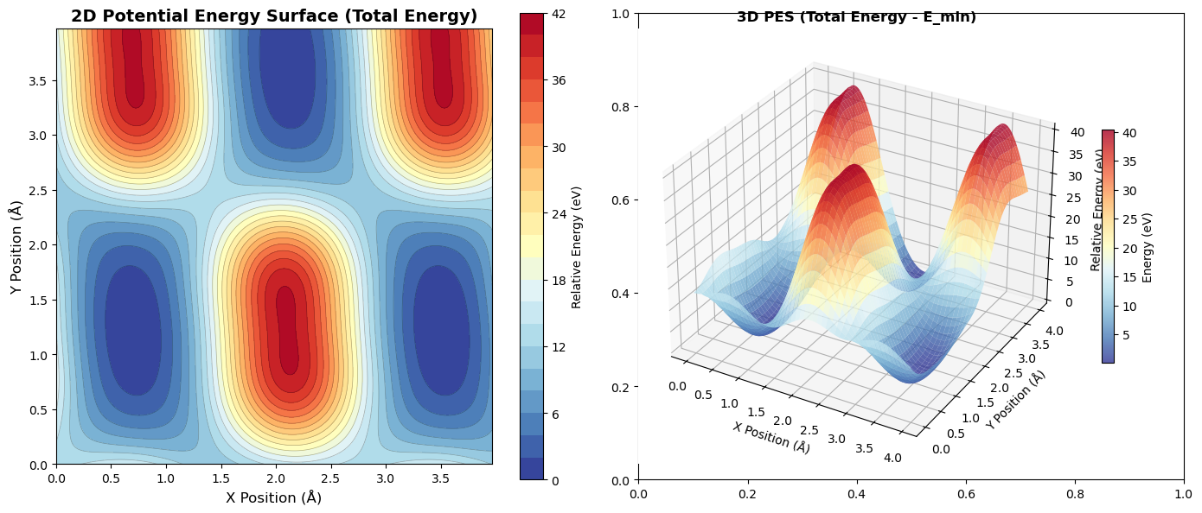
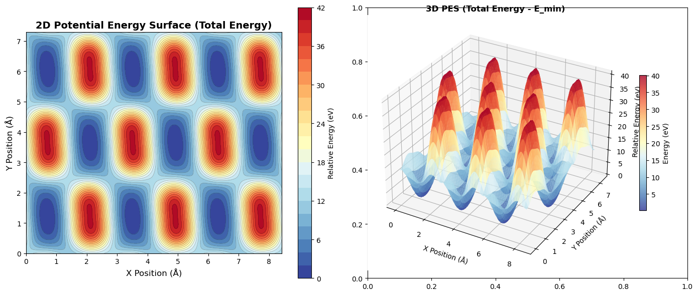

Slide 2
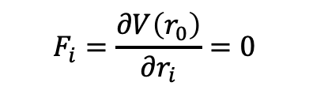
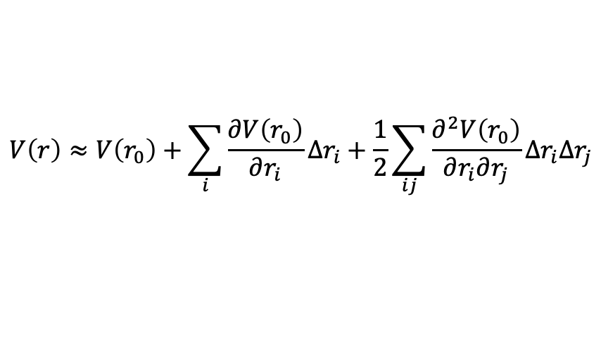
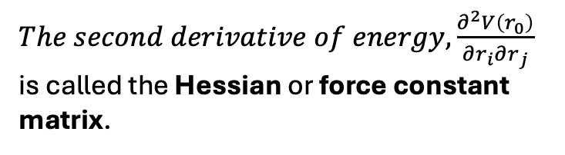
$$V\left(r\right)≈V\left(r_{0}\right)+\sum_{i}{\frac{∂V\left(r_{0}\right)}{∂r_{i}}∆r_{i}+\frac{1}{2}\sum_{ij}{\frac{∂^{2}V\left(r_{0}\right)}{∂r_{i}∂r_{j}}∆r_{i}∆r_{j}}}$$
$$F_{i}=\frac{∂V\left(r_{0}\right)}{∂r_{i}}=0$$
The potential energy surface that considers only second-order terms has the same energy as a system that is connected by springs, and thus, it is called the harmonic approximation.
$The second derivative of energy, \frac{∂^{2}V\left(r_{0}\right)}{∂r_{i}∂r_{j}}$ is called the Hessian or force constant matrix.

Slide 3
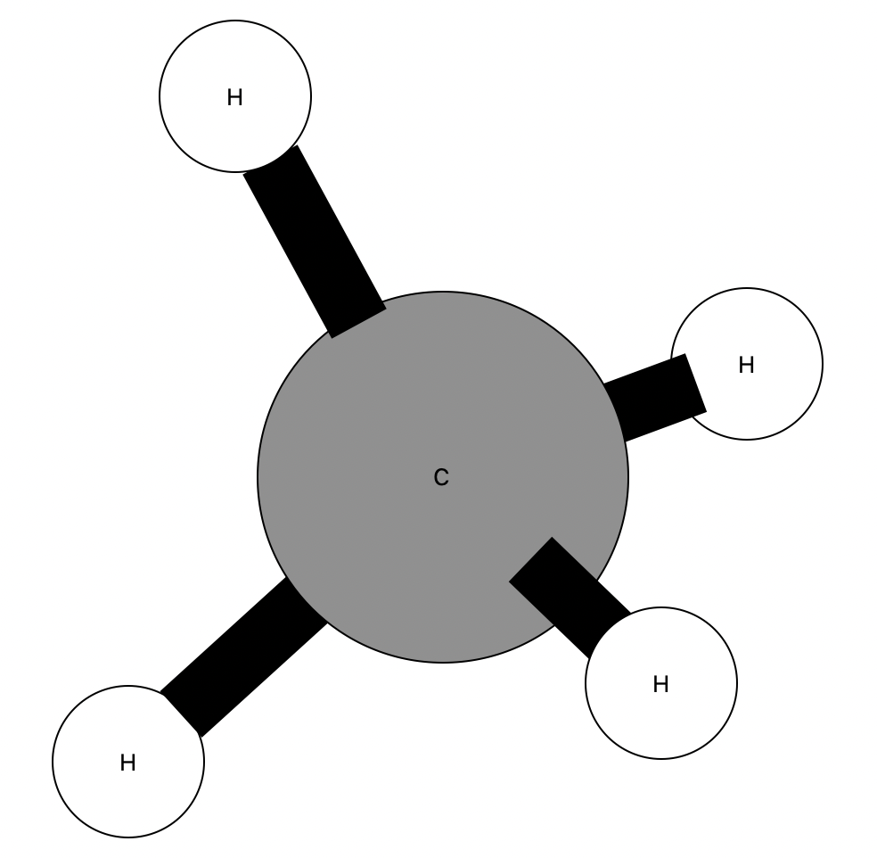
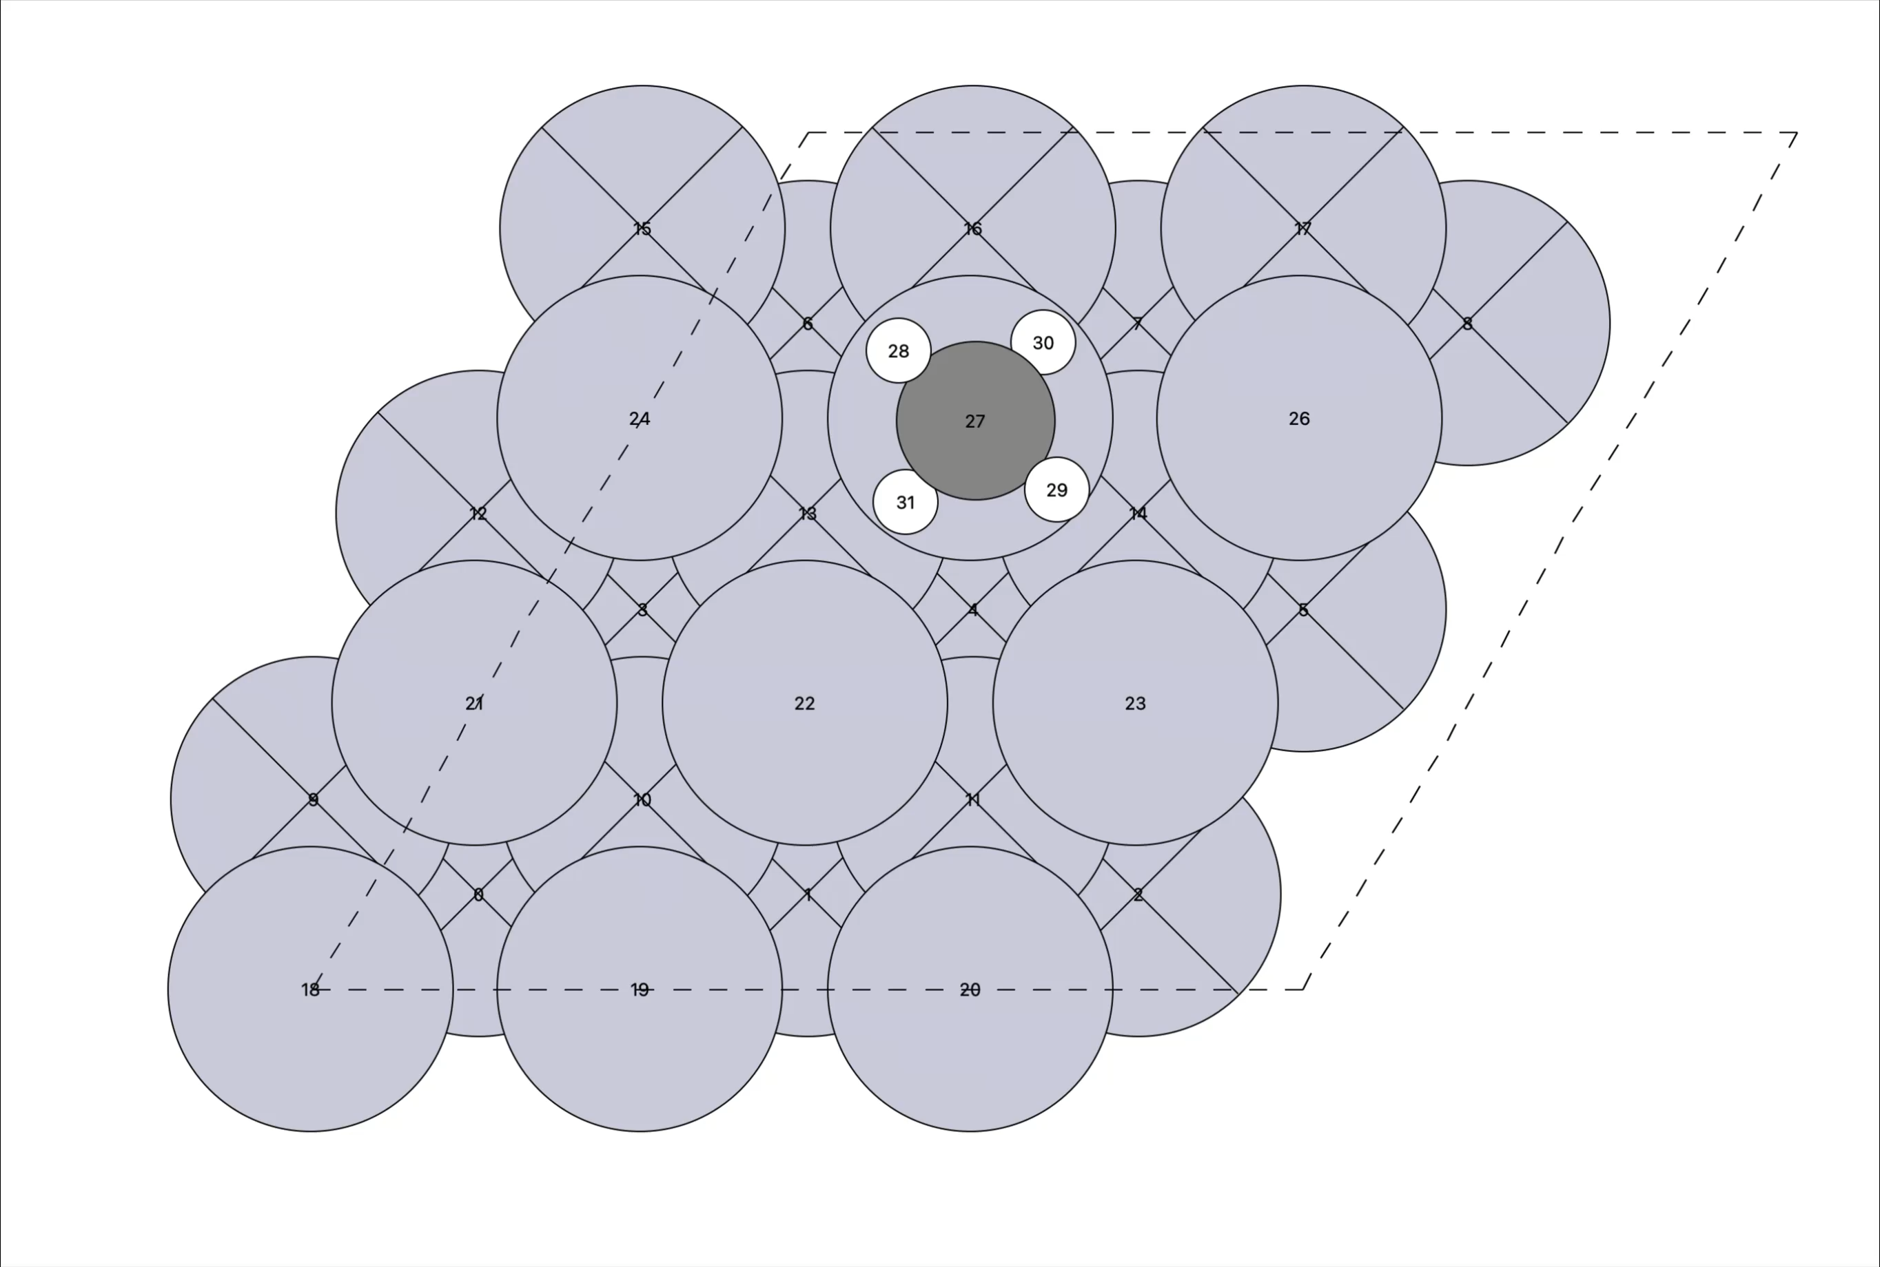
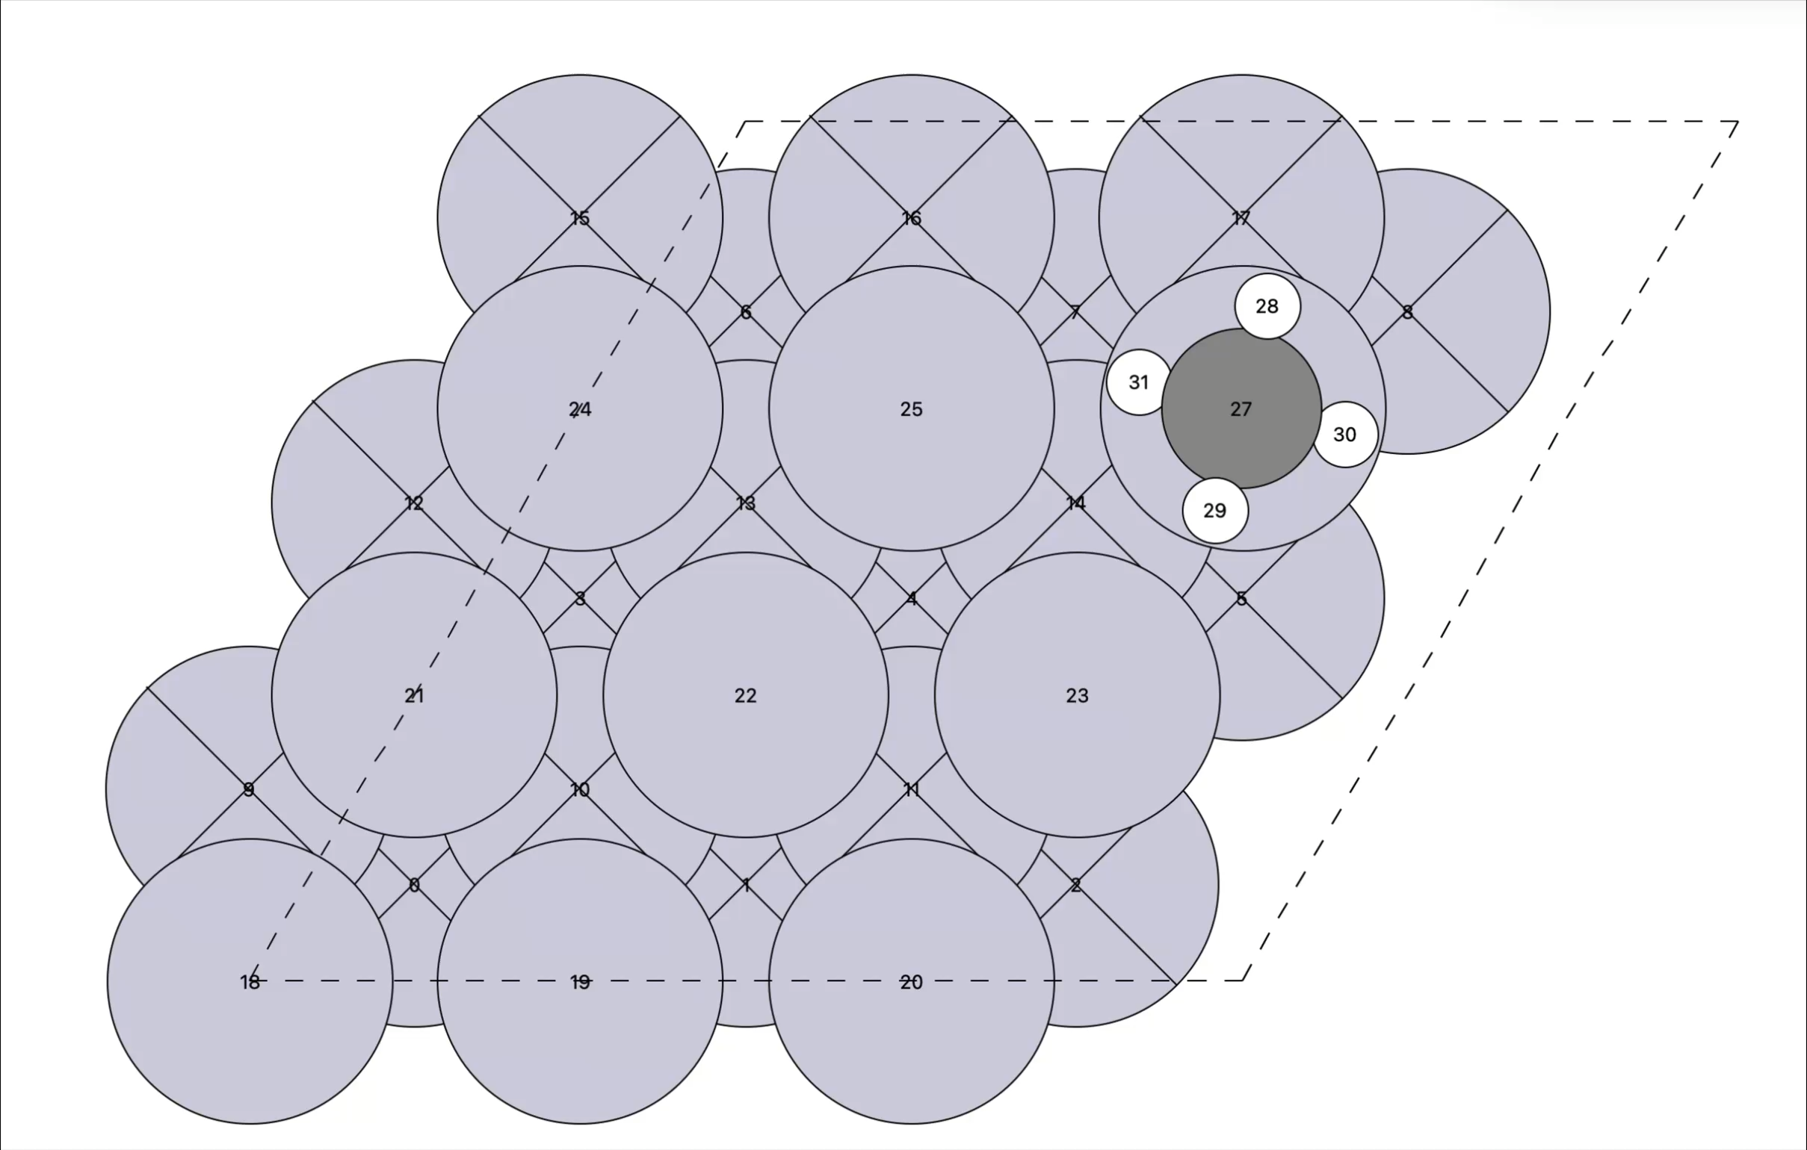
Unique site screening
All site screening
Initial CH4 molecule
Total number of sites found: 54 Site density: 8.79e+19 molecules/m^2
Unique single sites: 4
Unique site pairs: 71

Slide 4
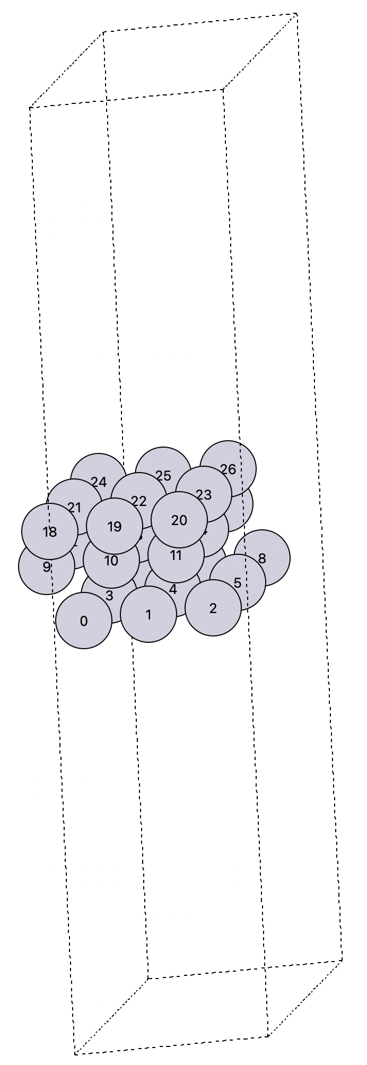
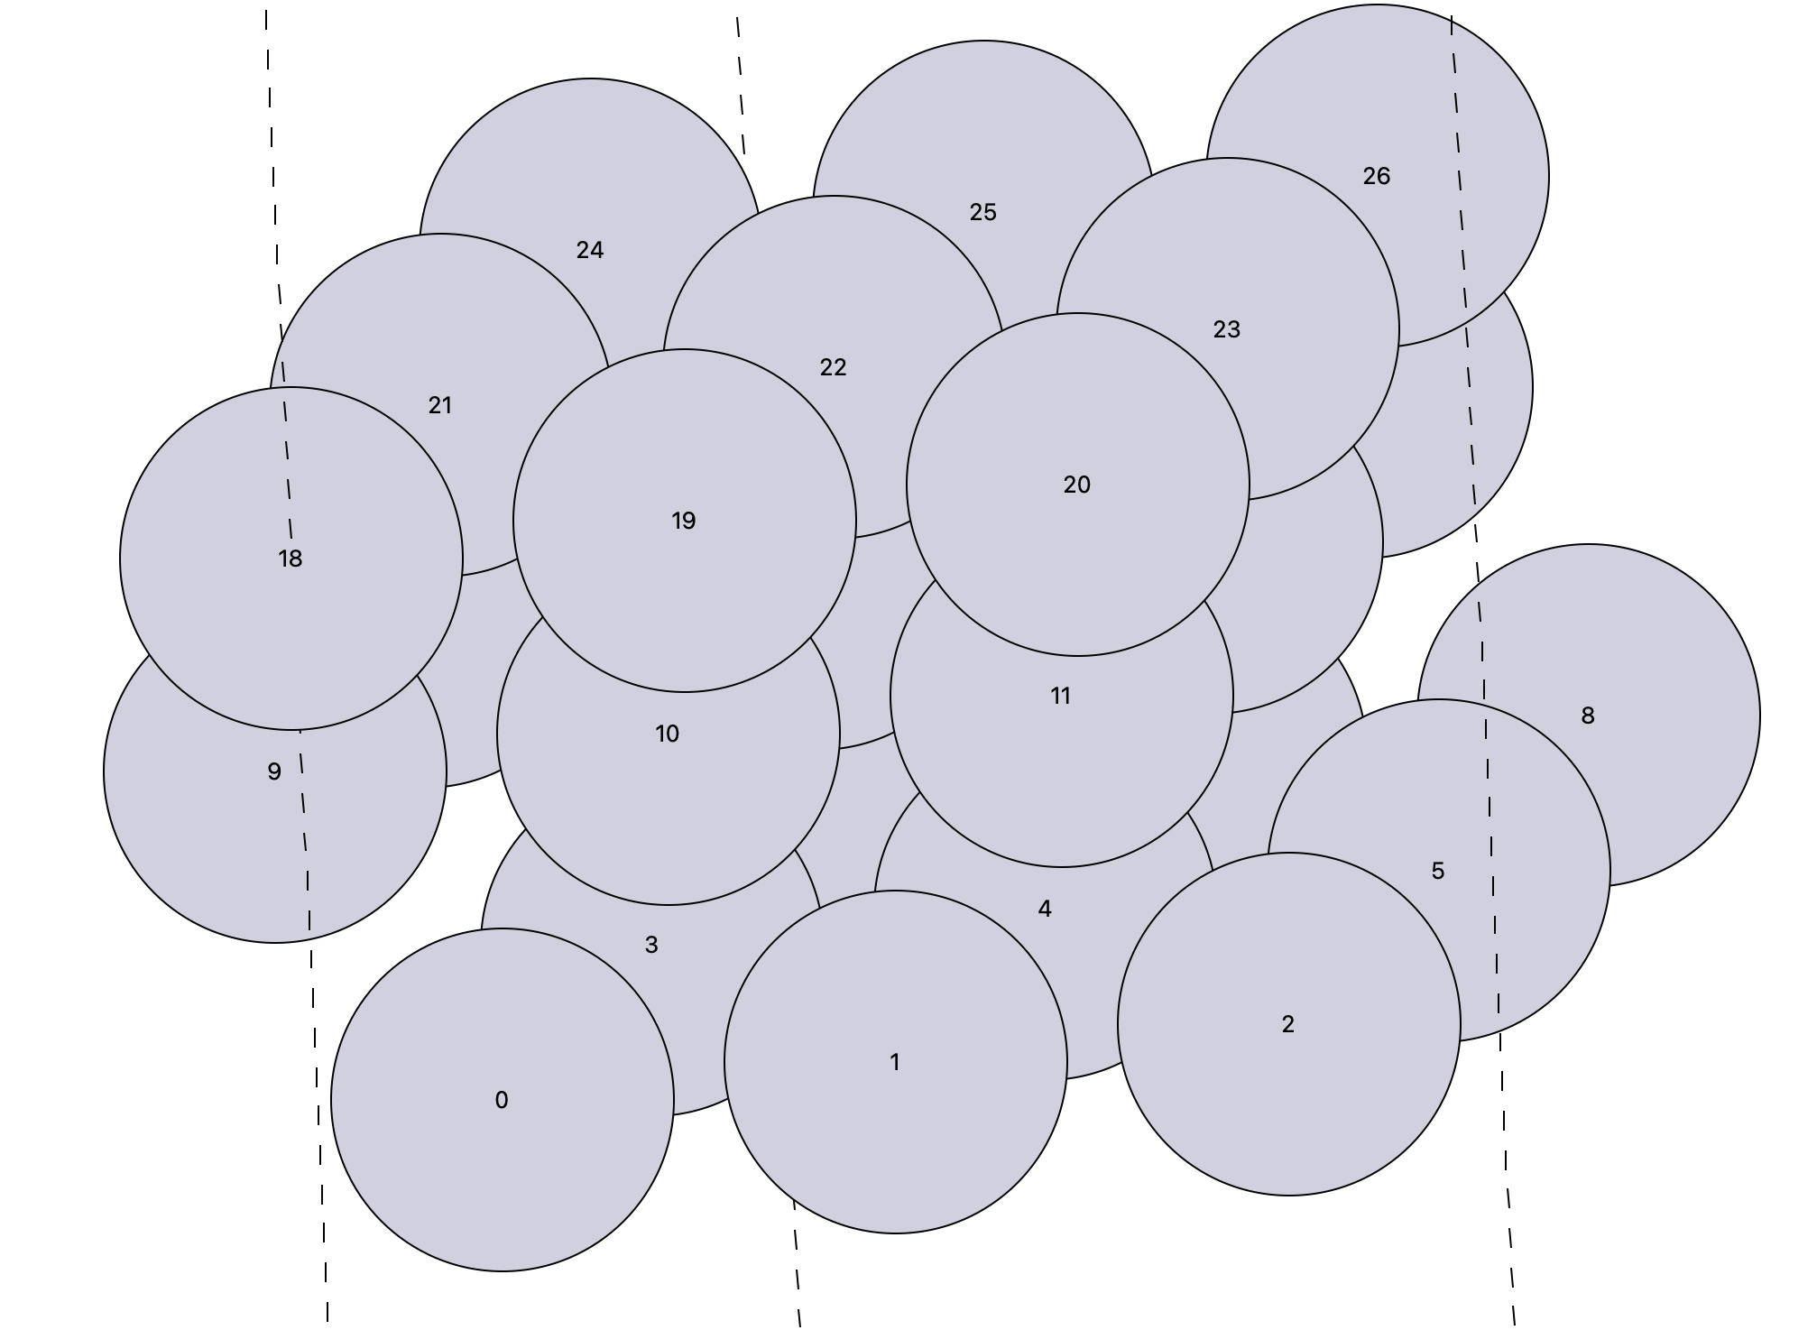
Optimized Slab

Slide 5
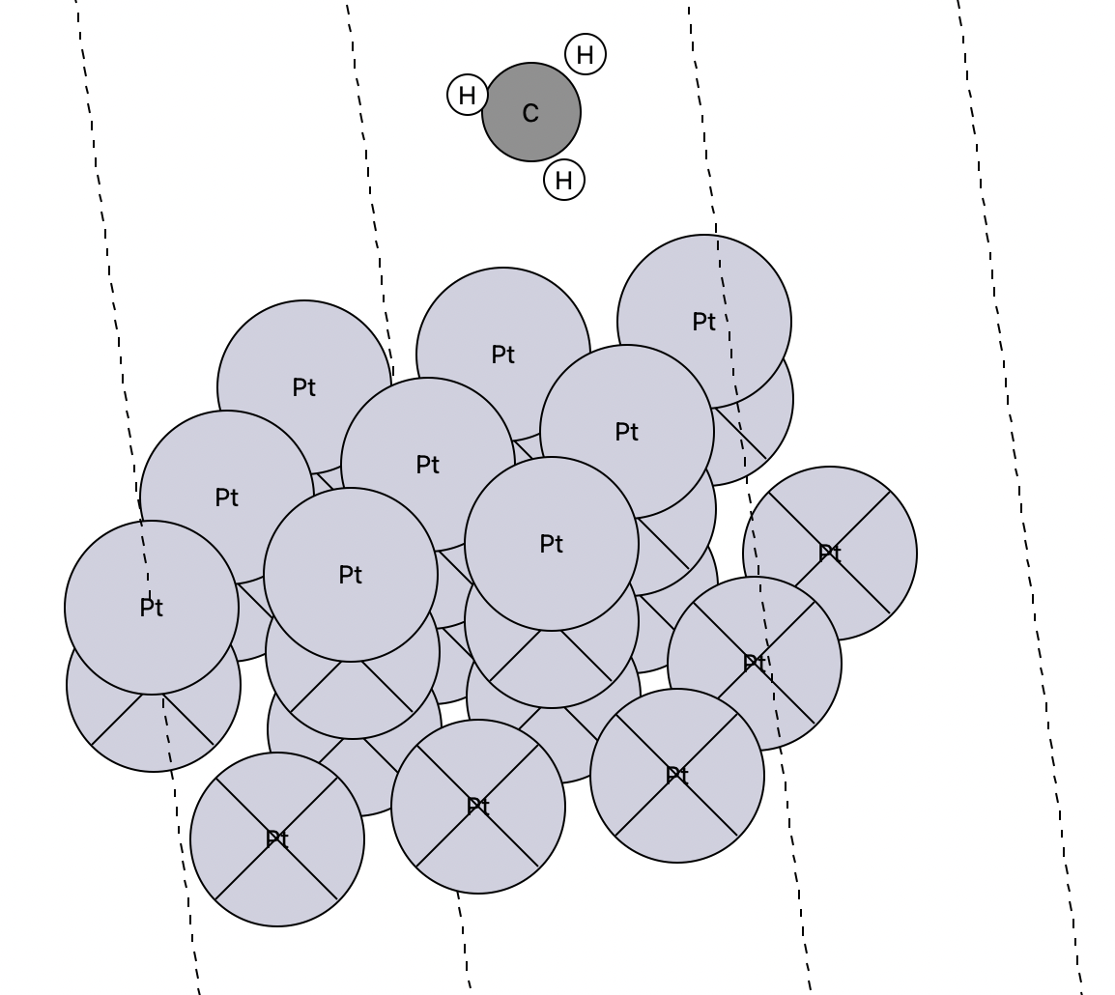
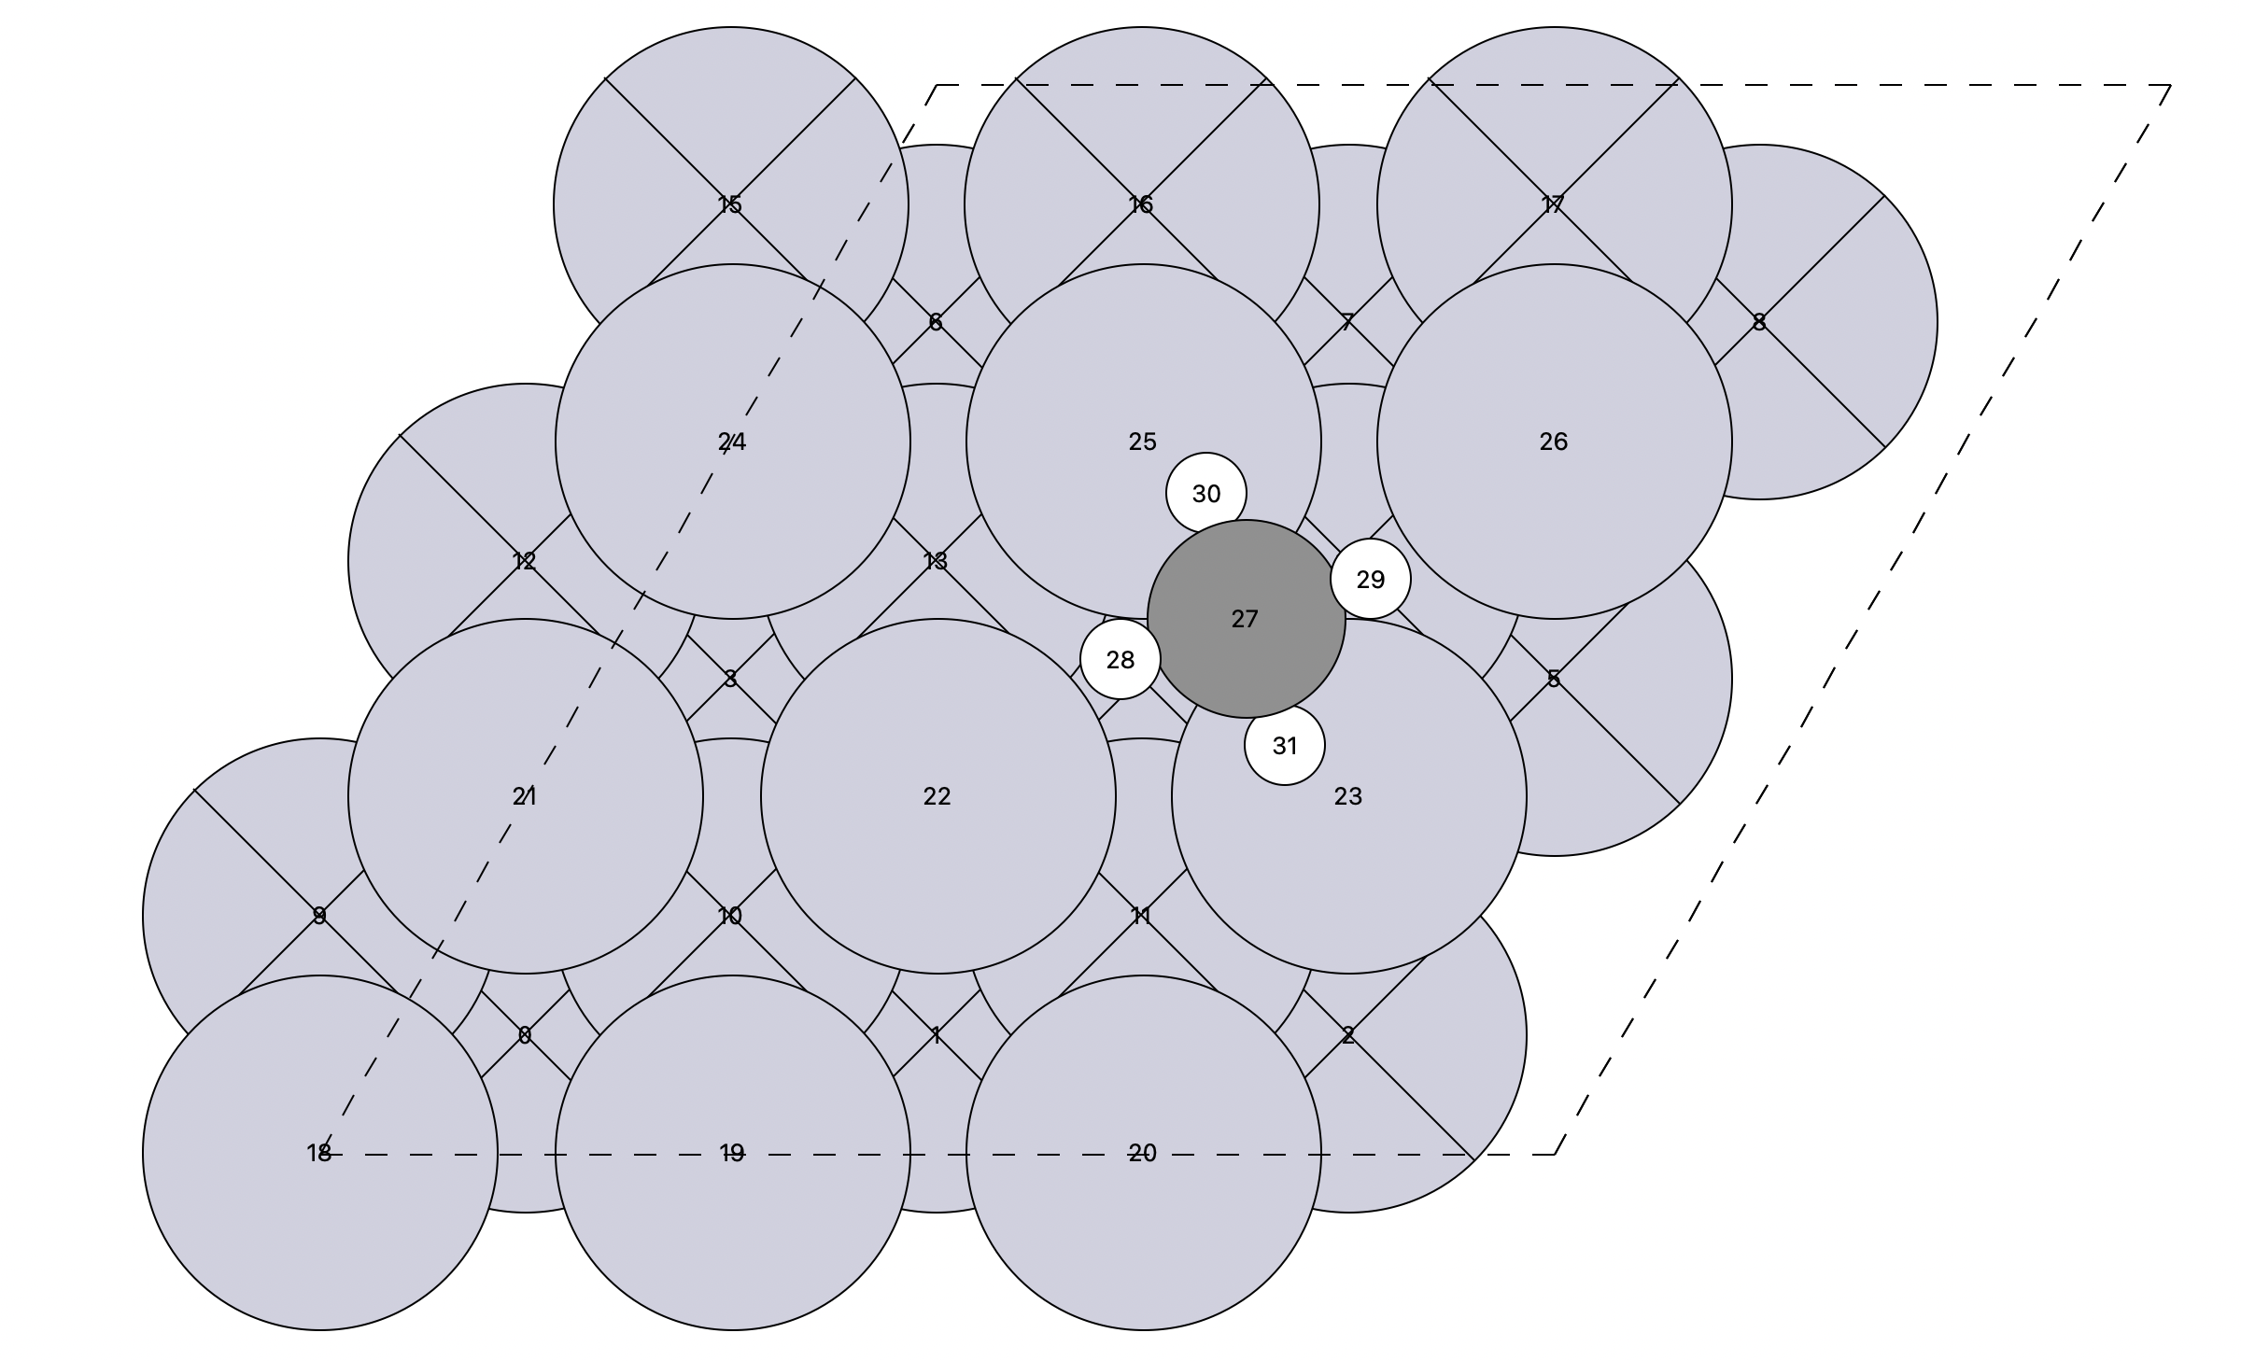
Made the best site the initial image and the second-best site the final image.
Initial translation image
Site type: 'bridge'

Slide 6
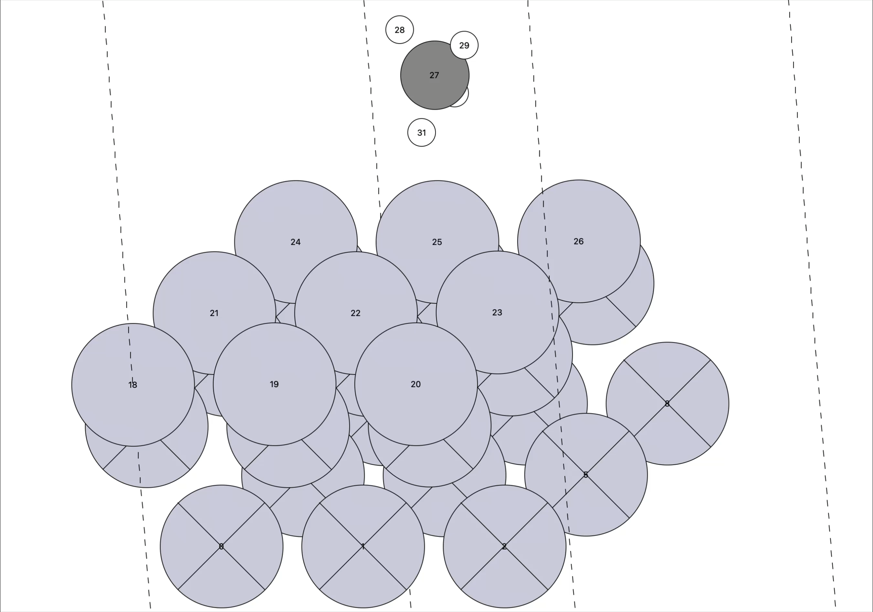
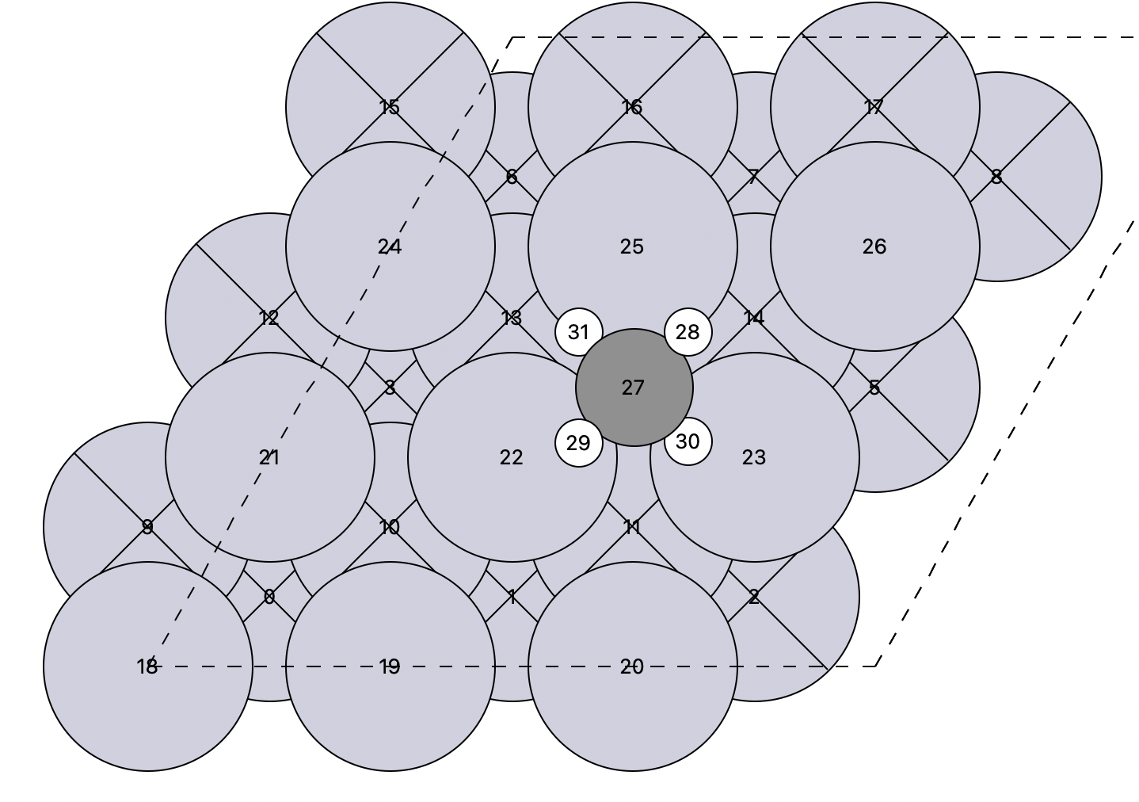
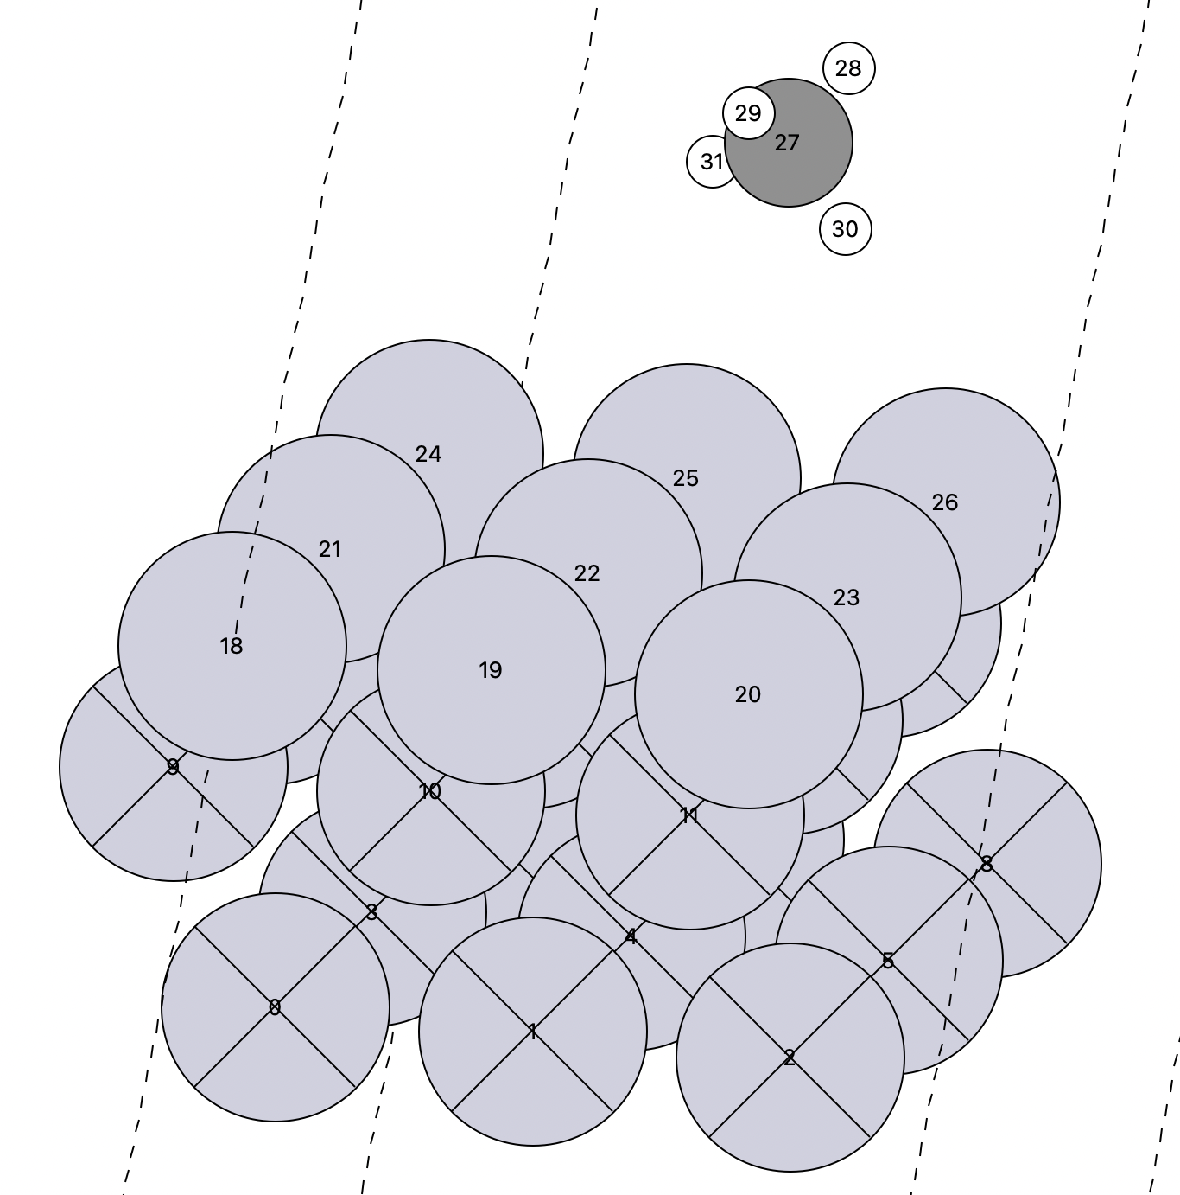
Made the best site the initial image and the second-best site the final image.
Final translation image
Site type: 'fcc'

Slide 7
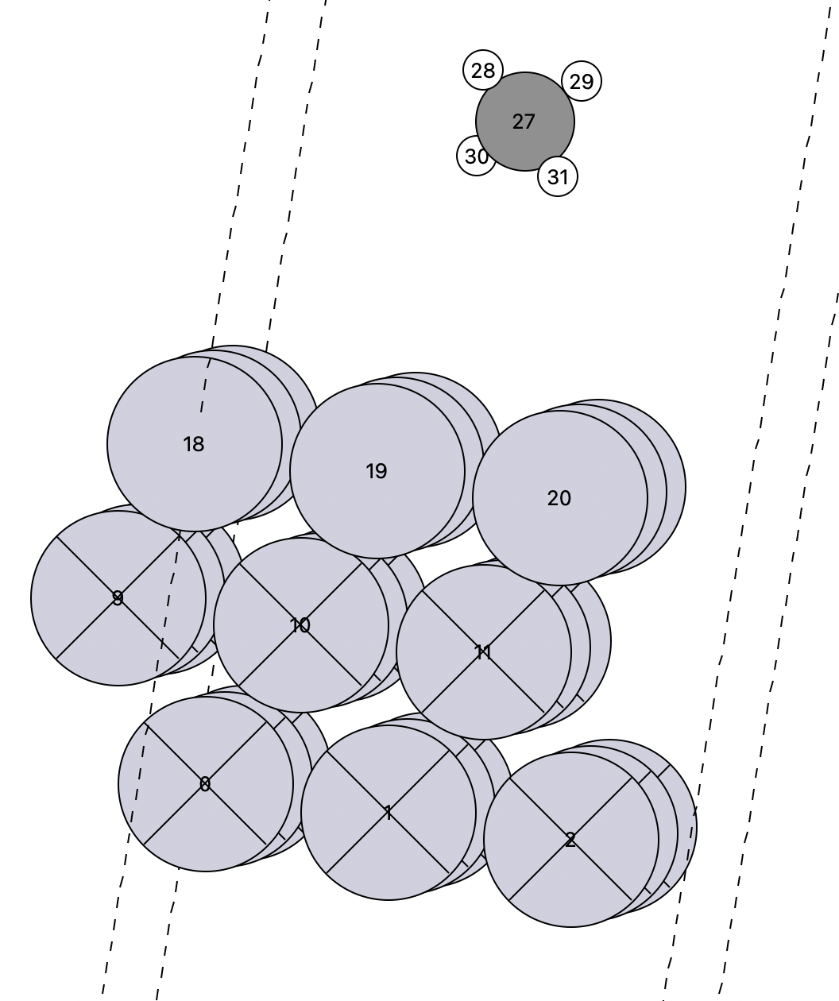
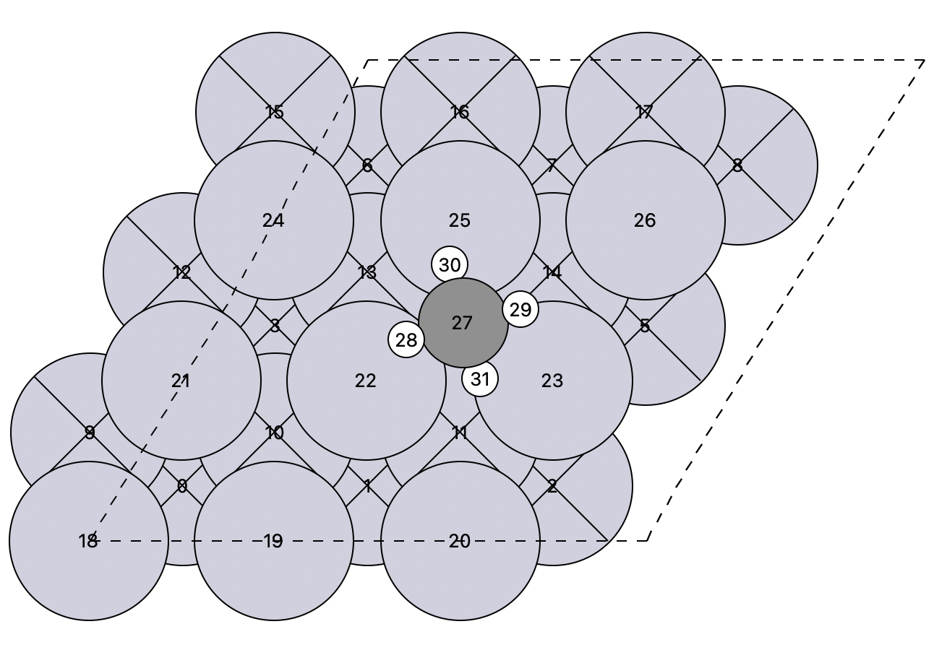
Made the final image the best site, and the initial image the image with the highest that matches the best image in height and and angle.
Initial image
Site type: 'fcc'

Slide 8
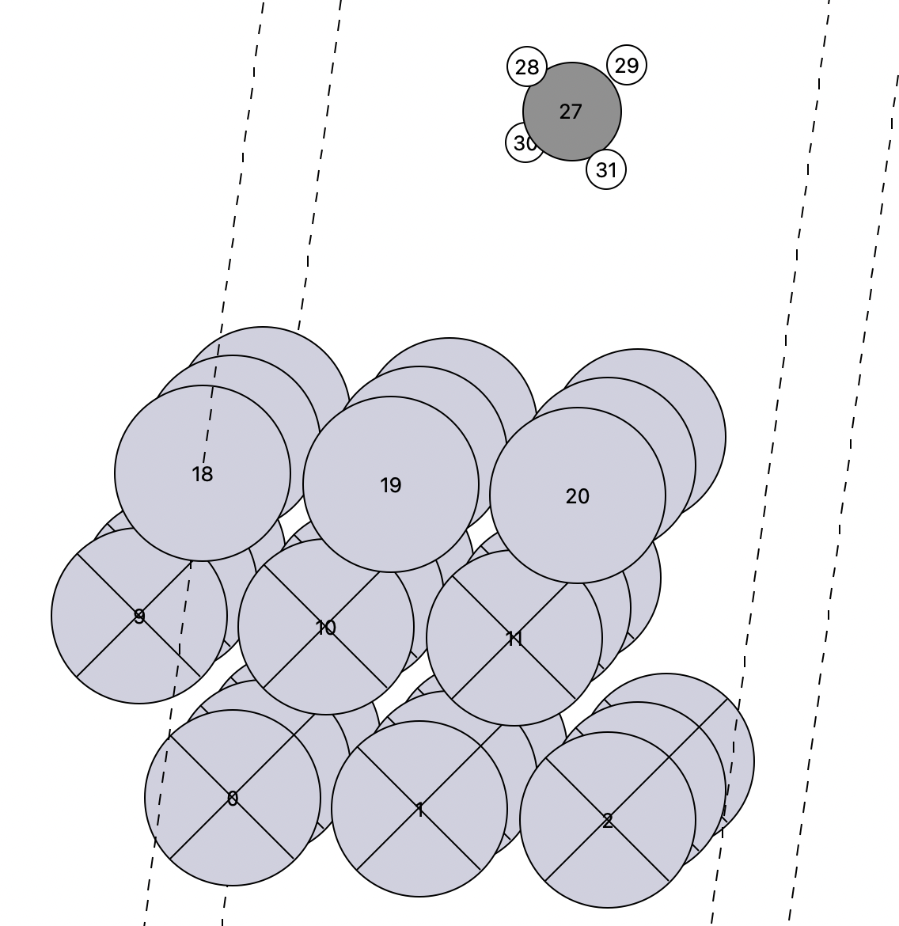
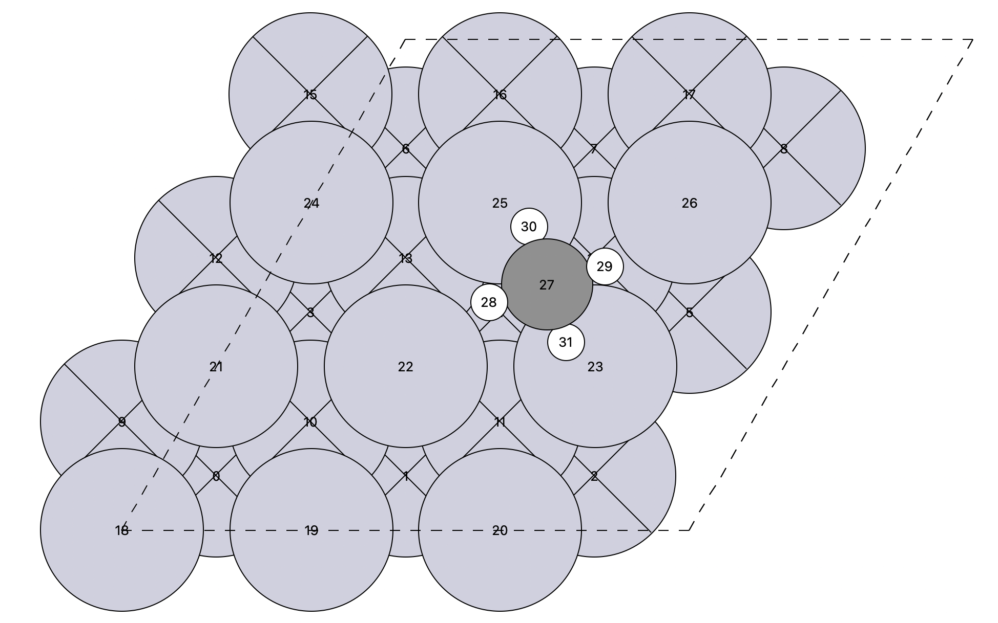
Made the final image the best site, and the initial image the image with the highest that matches the best image in height and and angle.
Final image

Slide 9
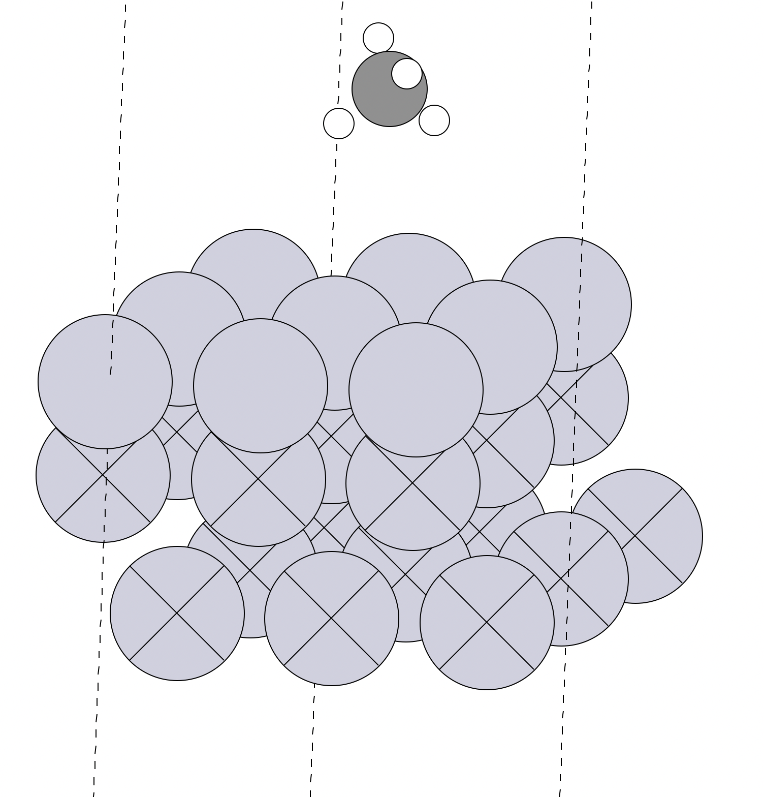
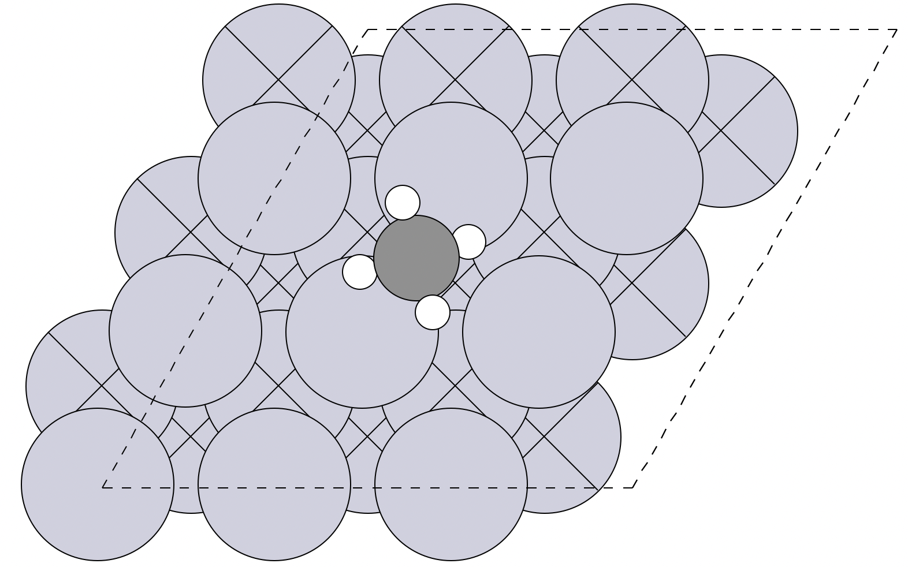
Result of screening all sites
Initial Image
Site type: 'bridge'

Slide 10
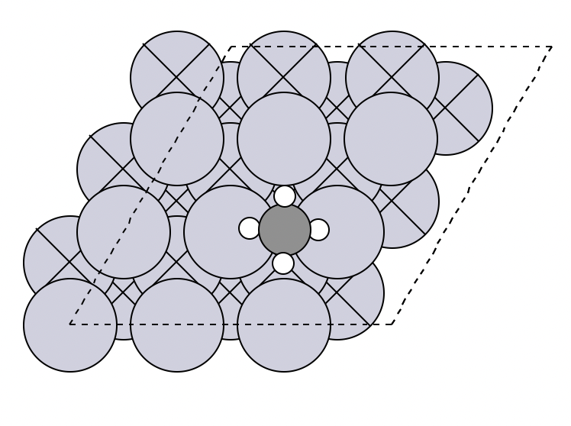
Result of screening all sites
Final Image
Site type: 'bridge'

Slide 11
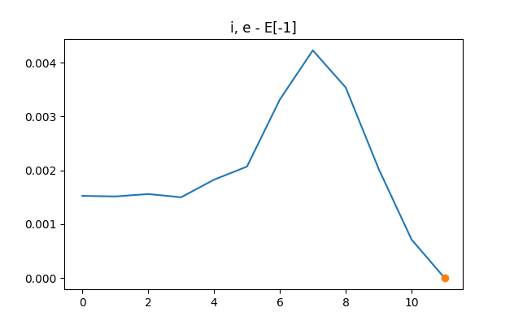
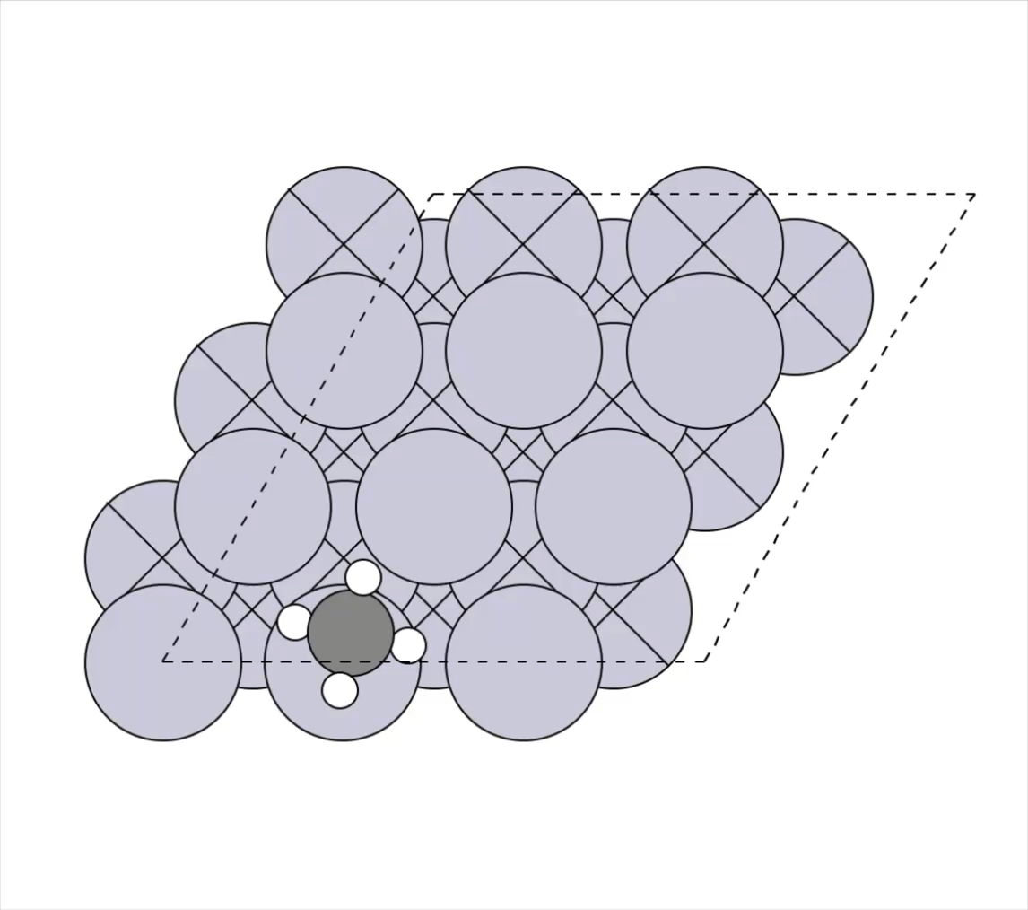
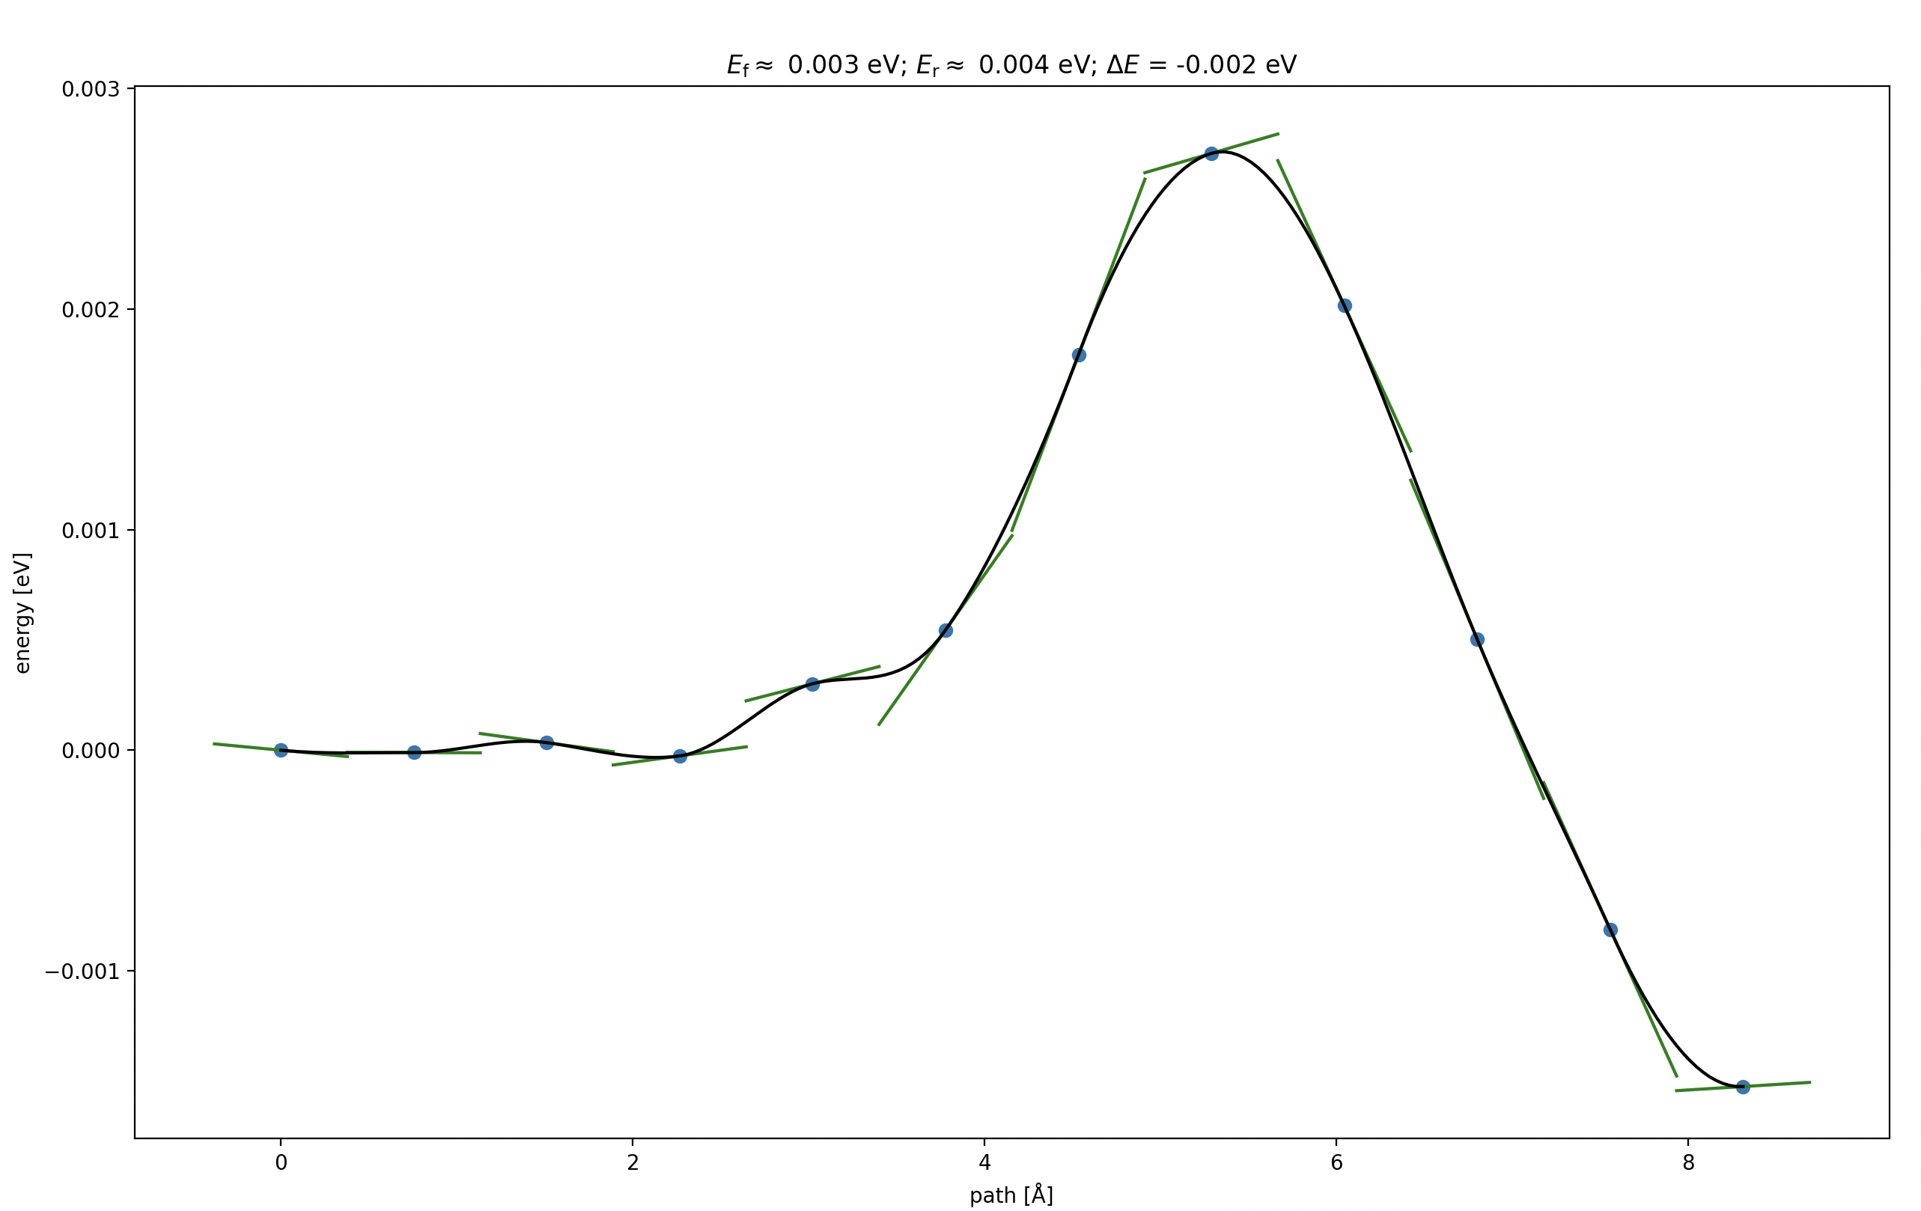
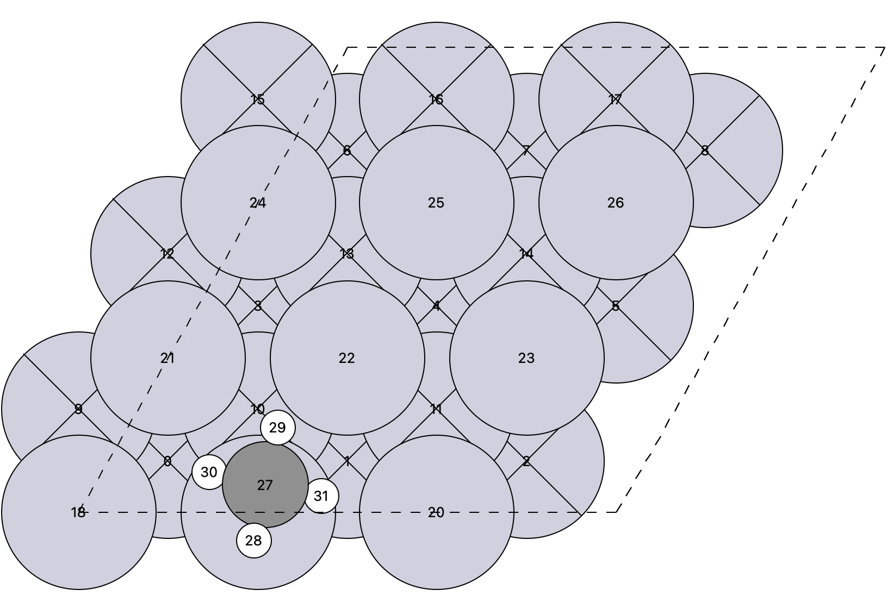
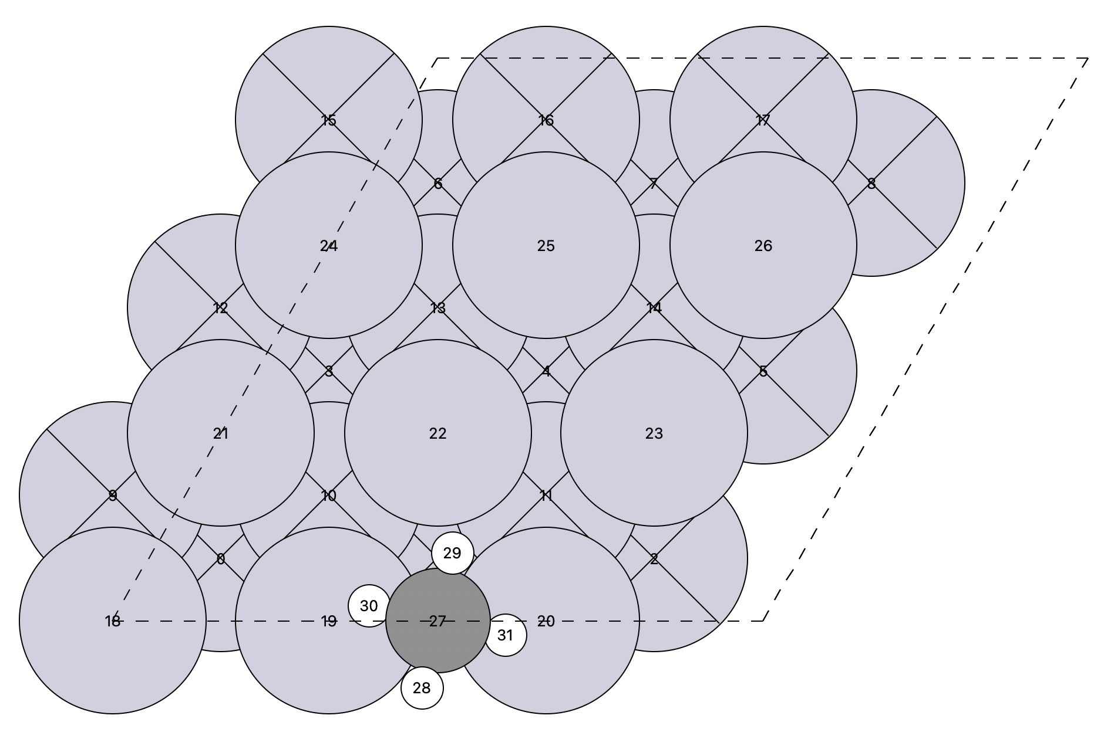
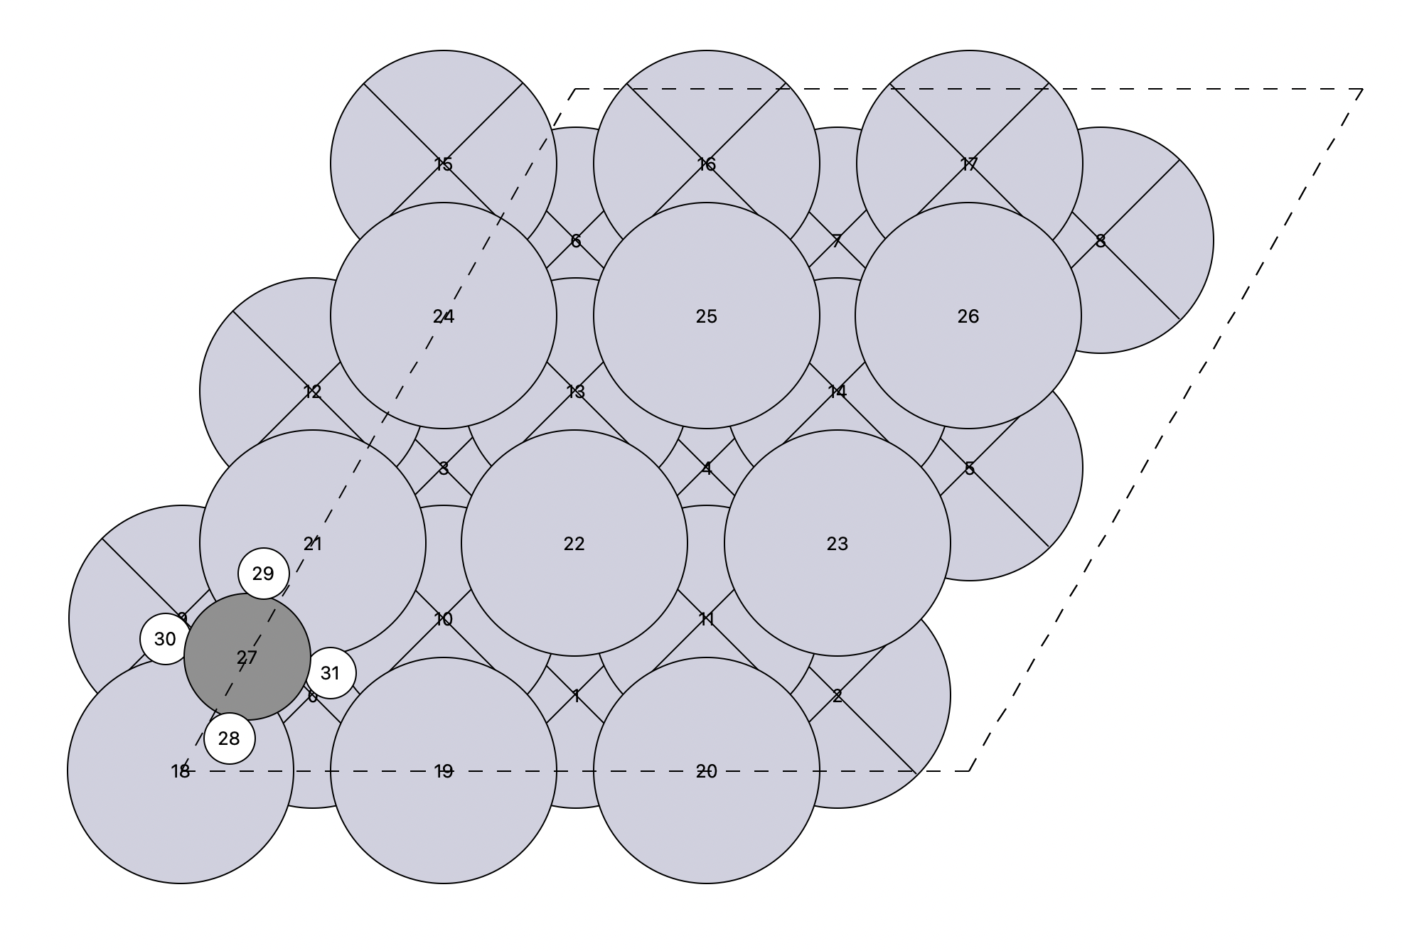
Pure Translation between two Adjacent sites
Initial
Saddle structure
Final

Slide 12
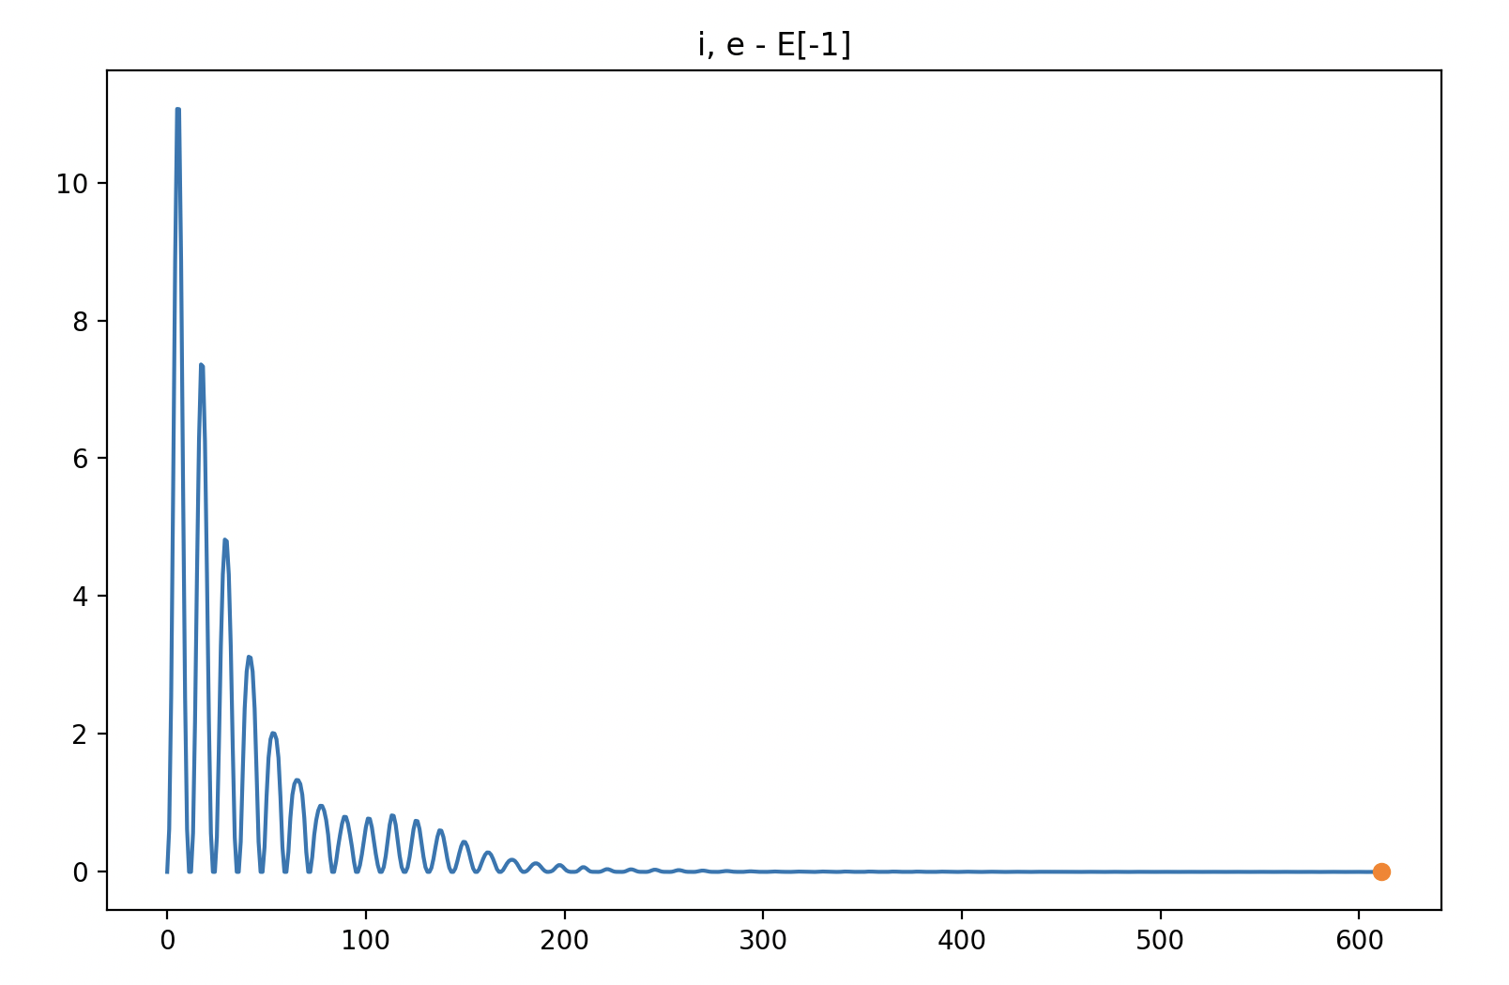
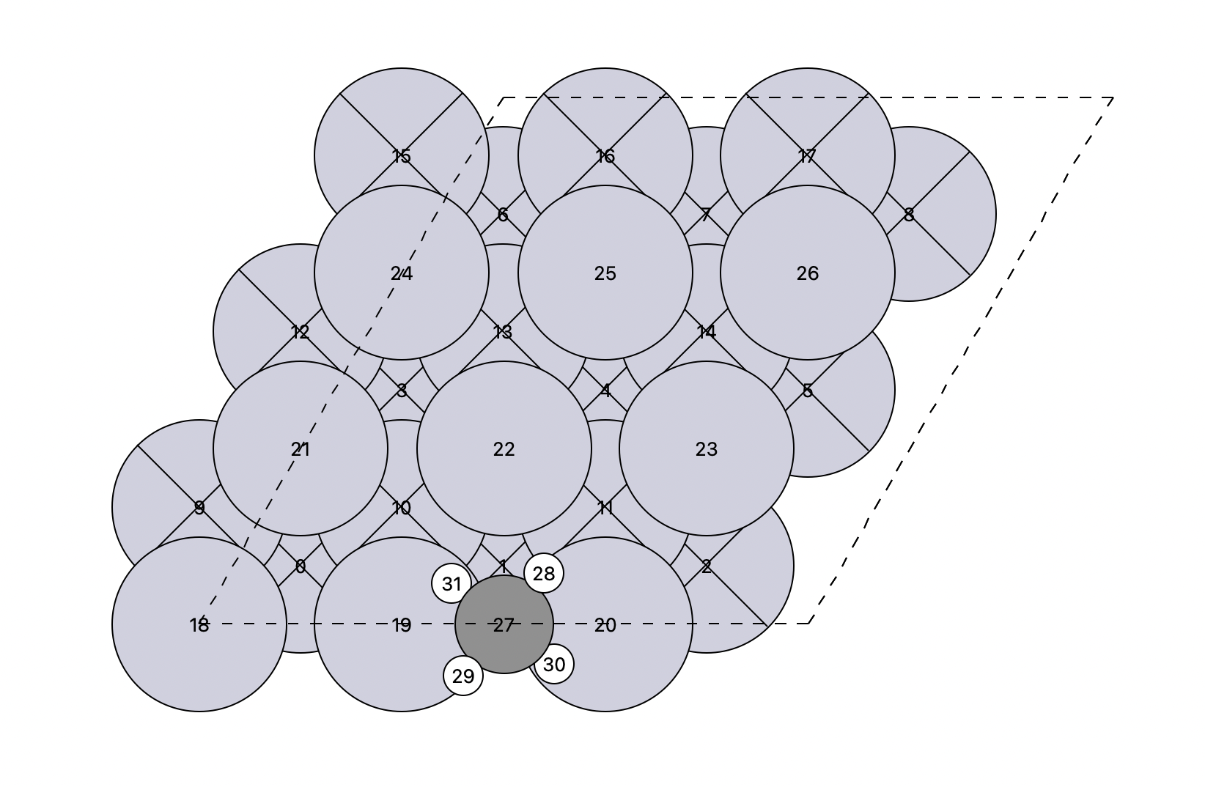
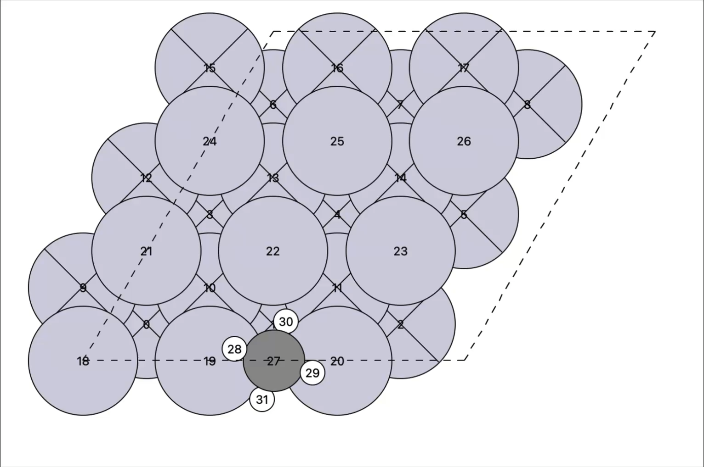
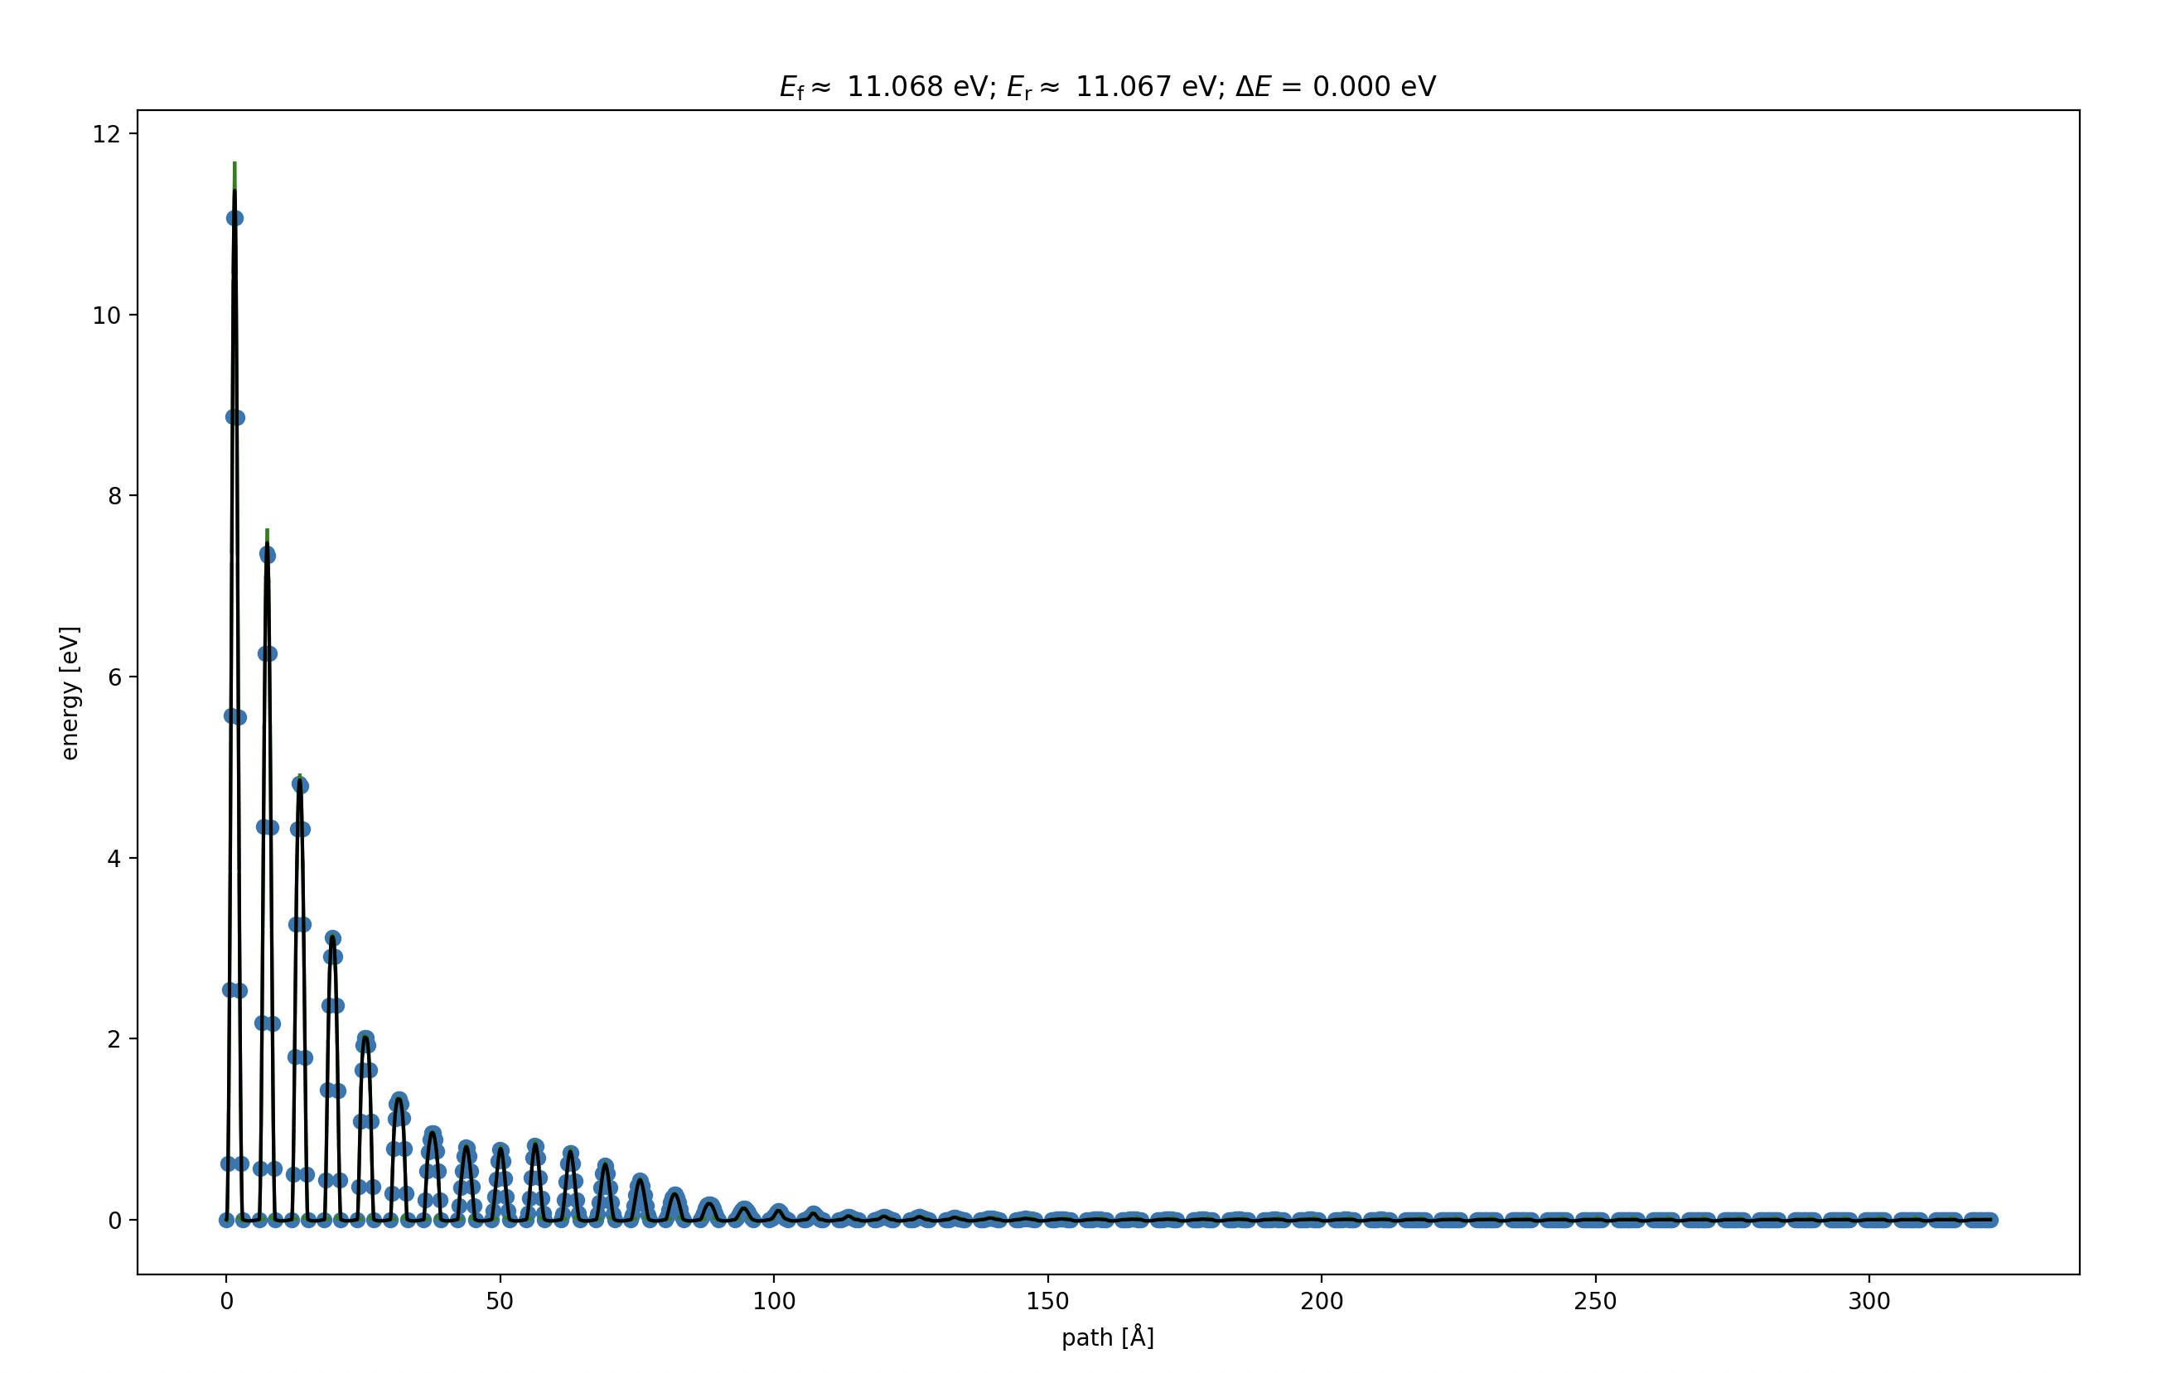
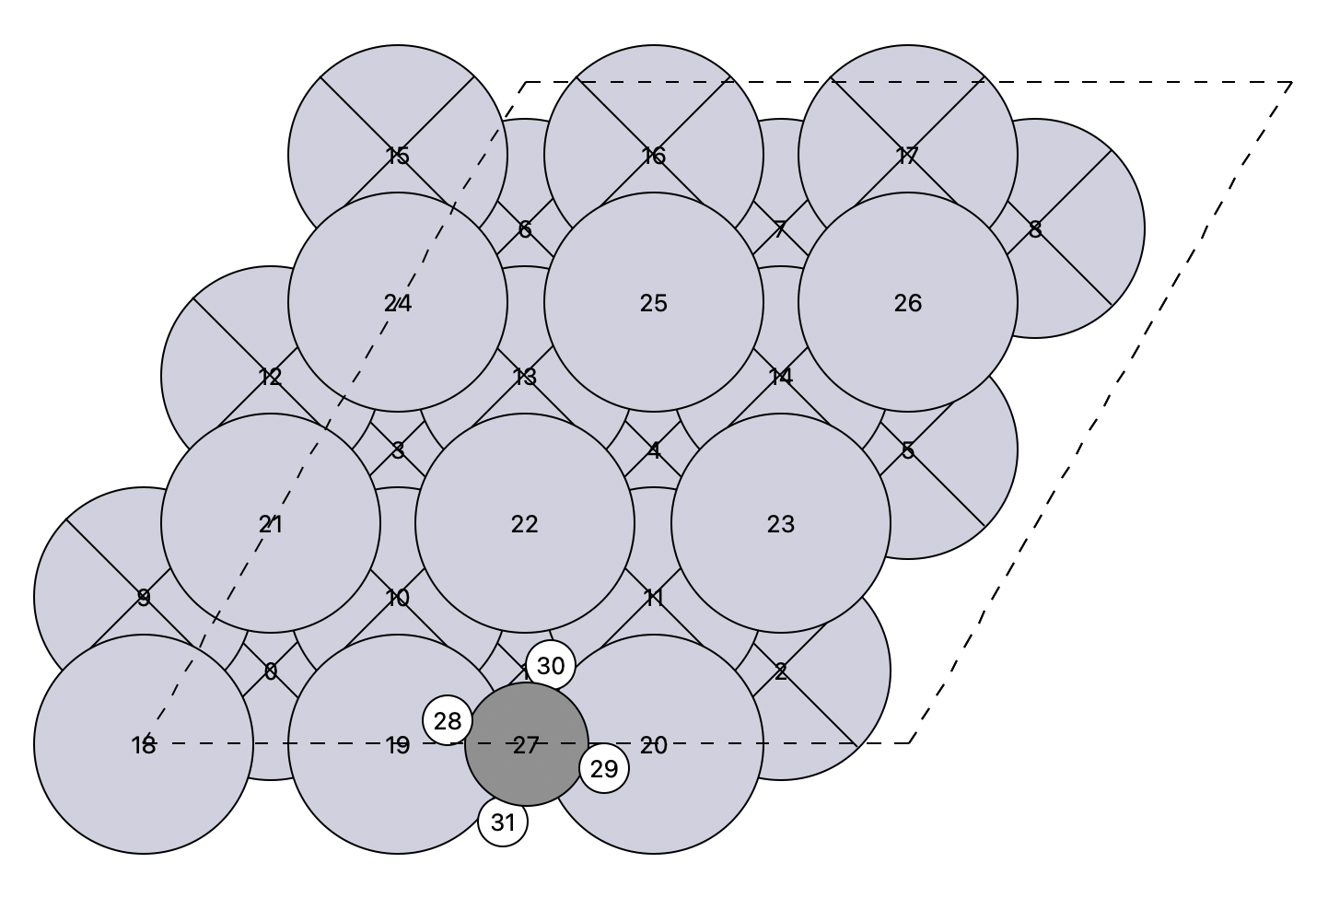
Pure Rotation at 120⁰ - Initial image as the final structure for translation

Slide 13
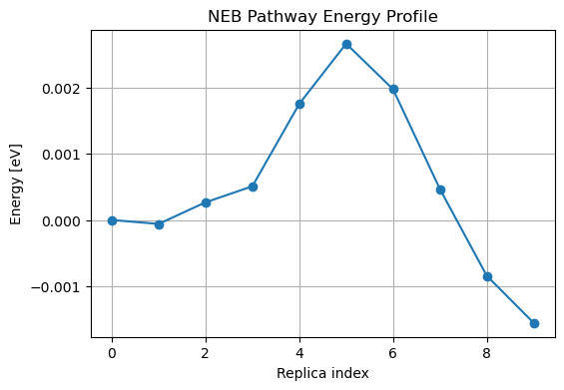
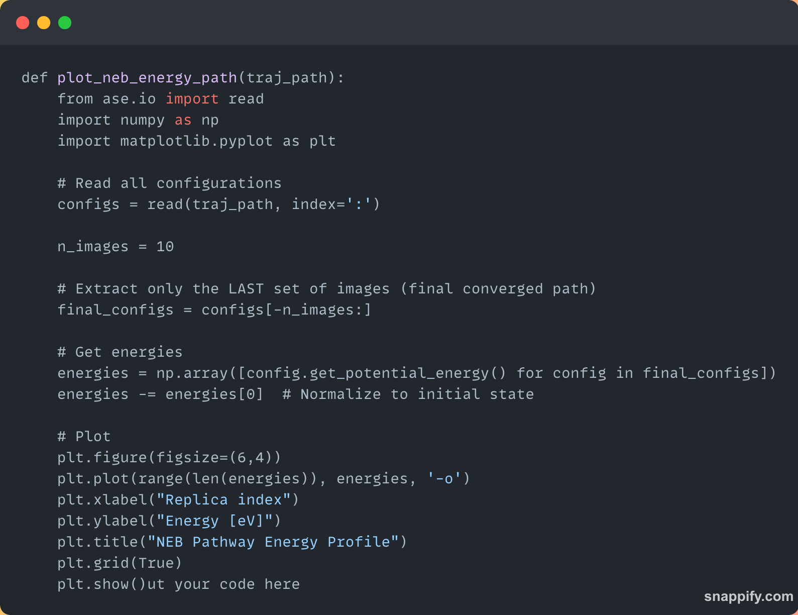
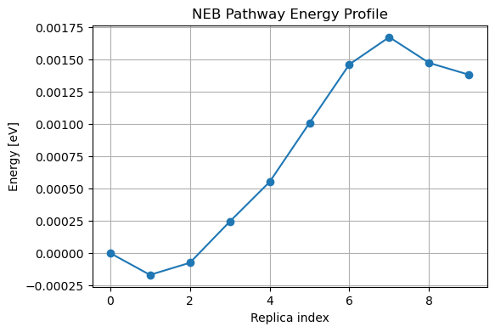
Energy profile for pure hindered translation
Energy profile for pure hindered rotation

Slide 14
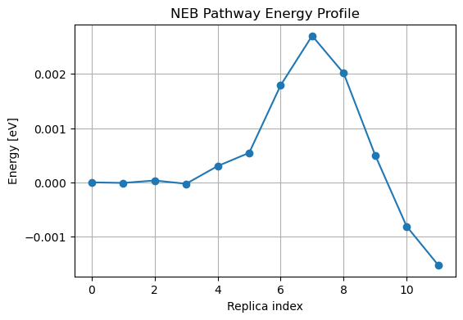

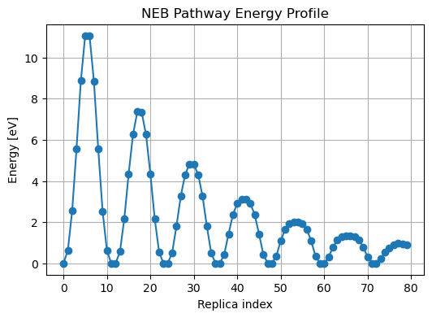
Energy profile for pure hindered translation
Energy profile for pure hindered rotation

Slide 15
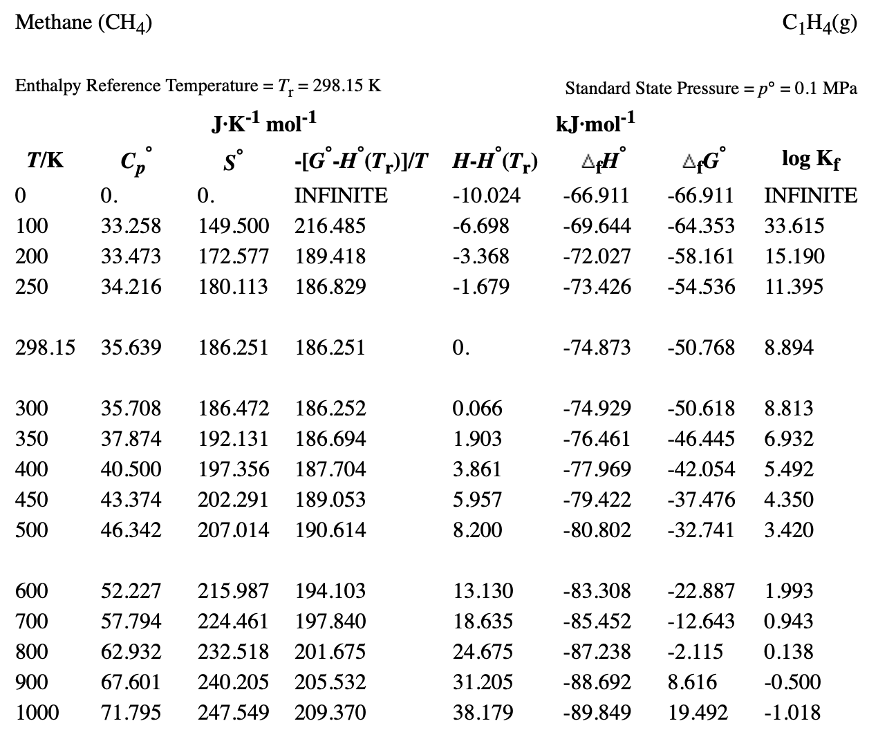
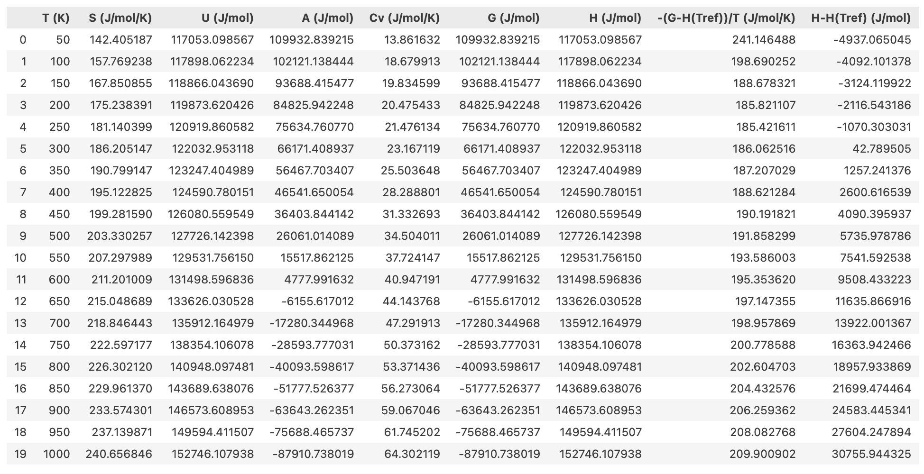
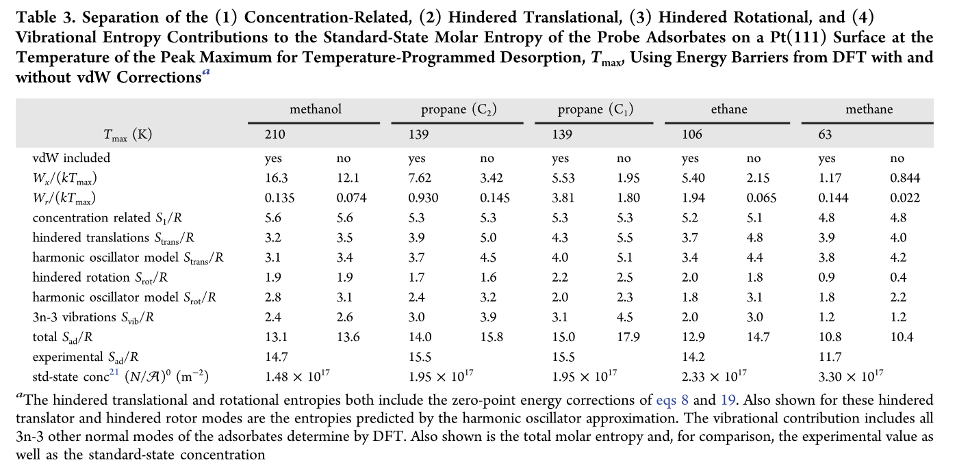
JANAF-Like Table for CH4 Gas & CH4/Pt(111)

Slide 16
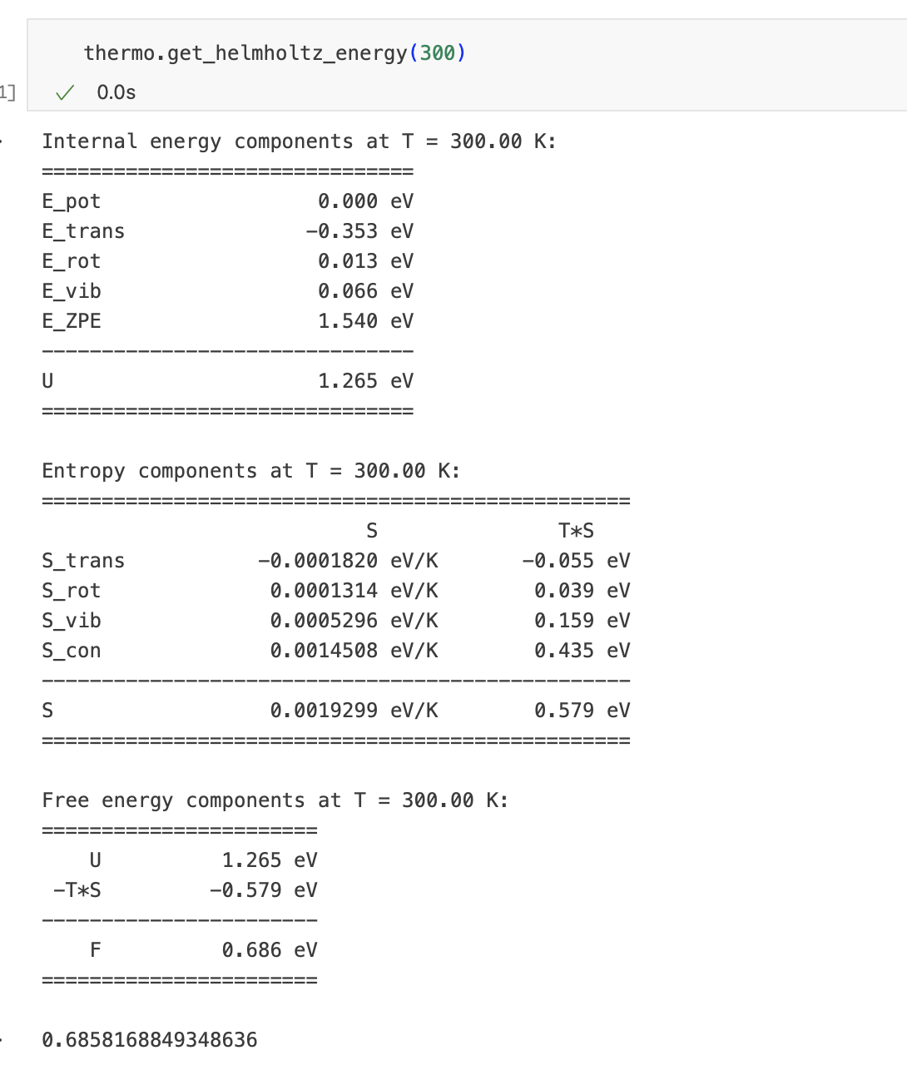
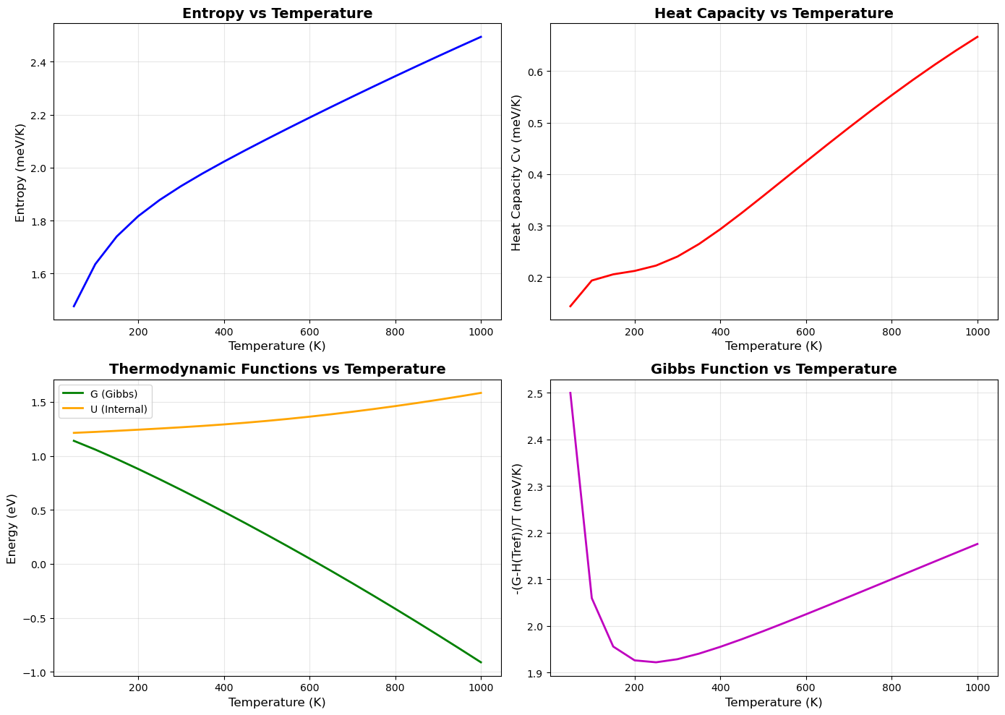
Component-wise thermos at T = 300 K

Slide 17
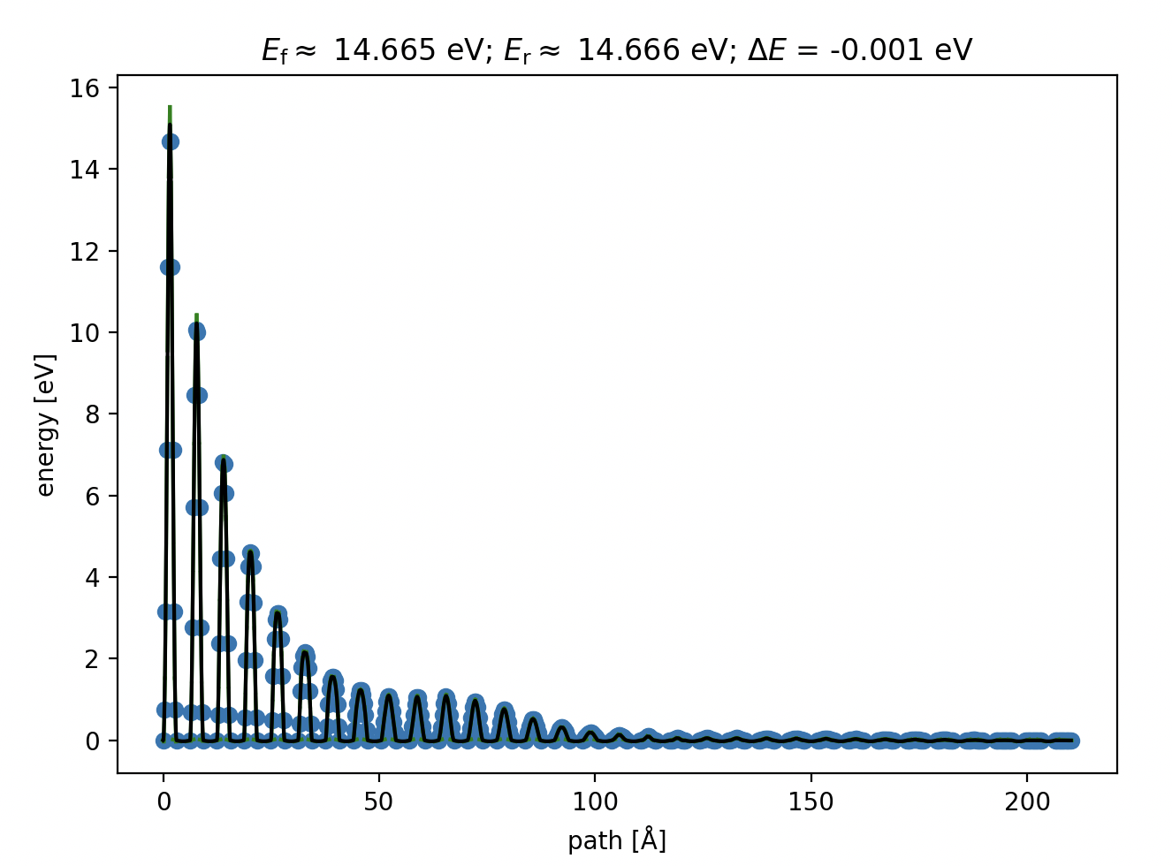
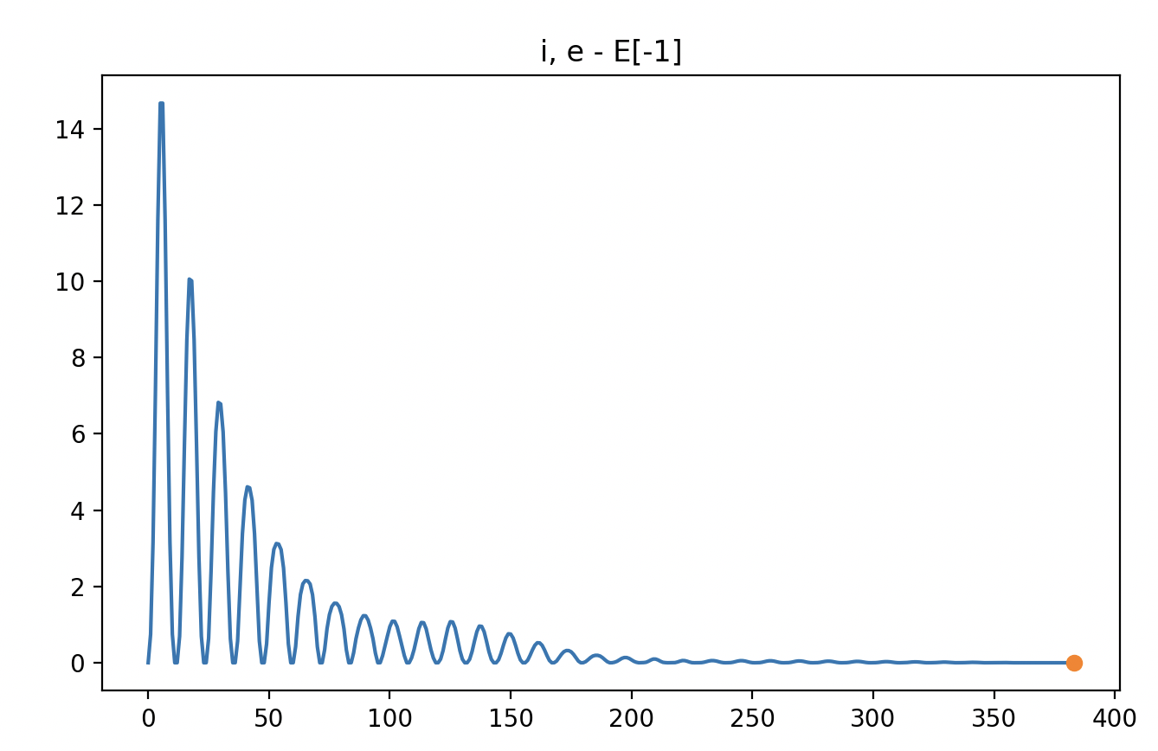
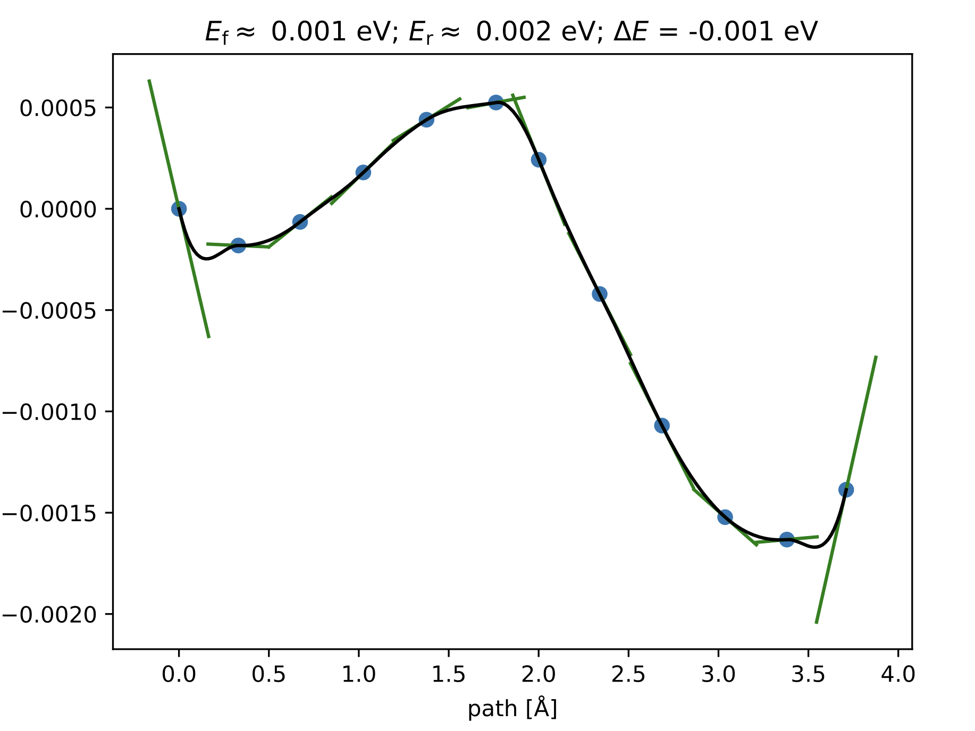
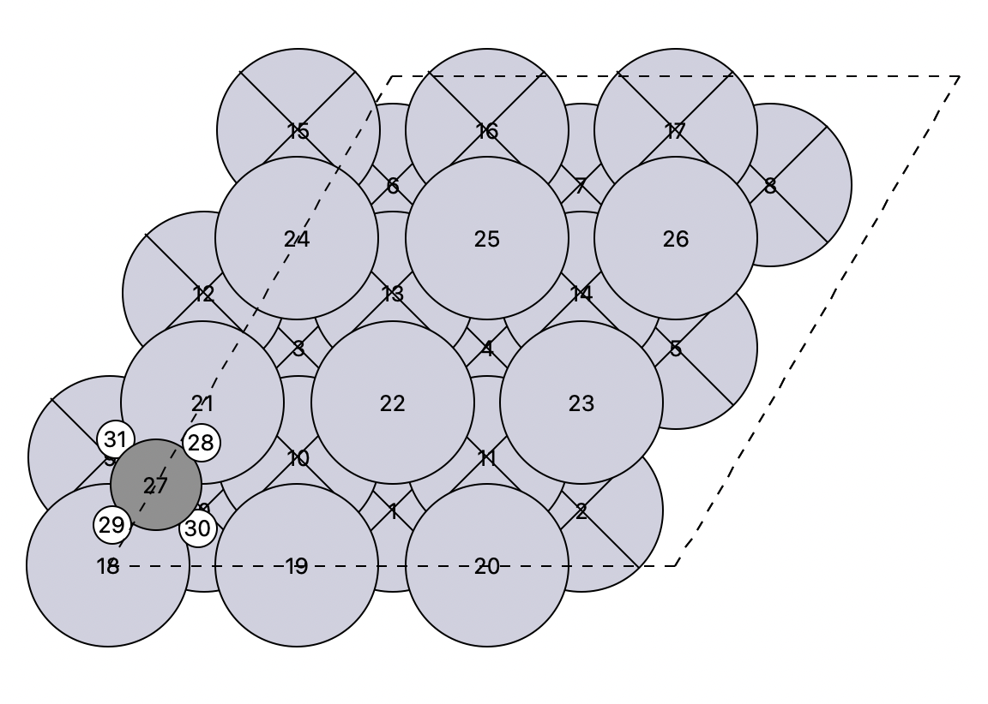
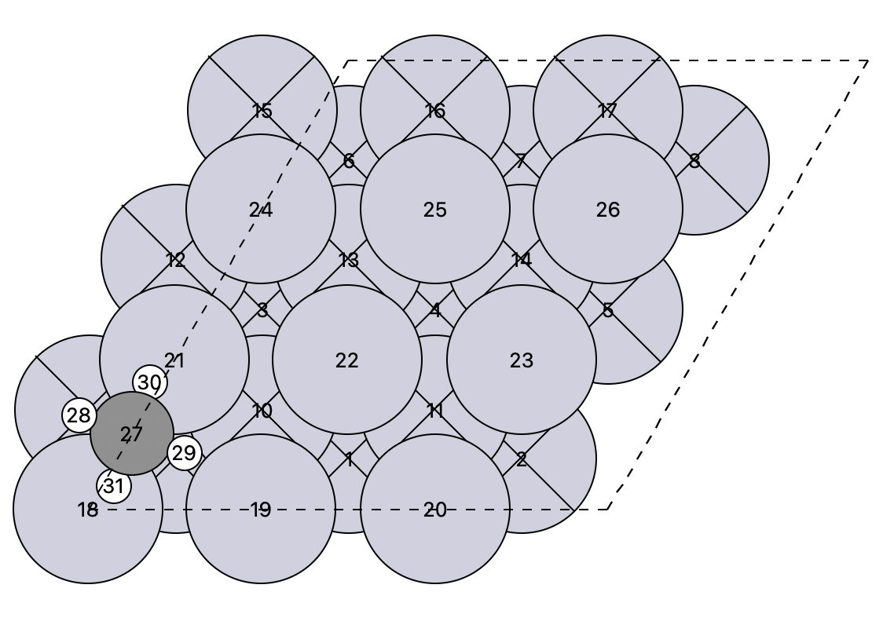
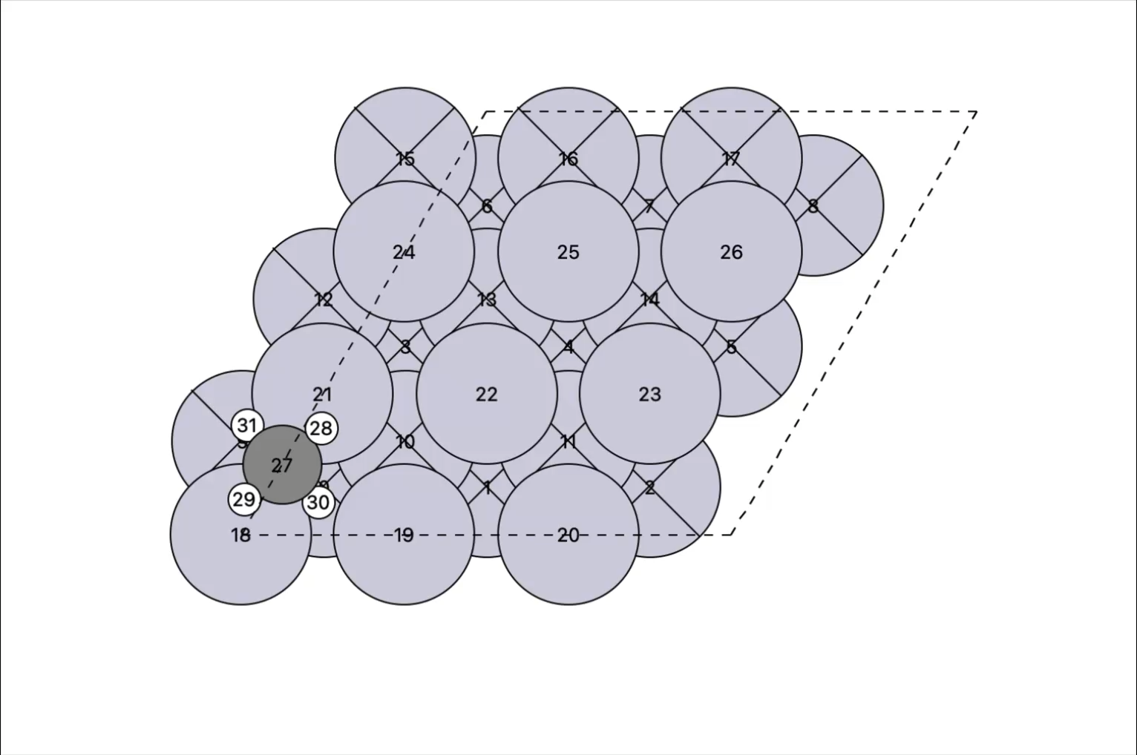
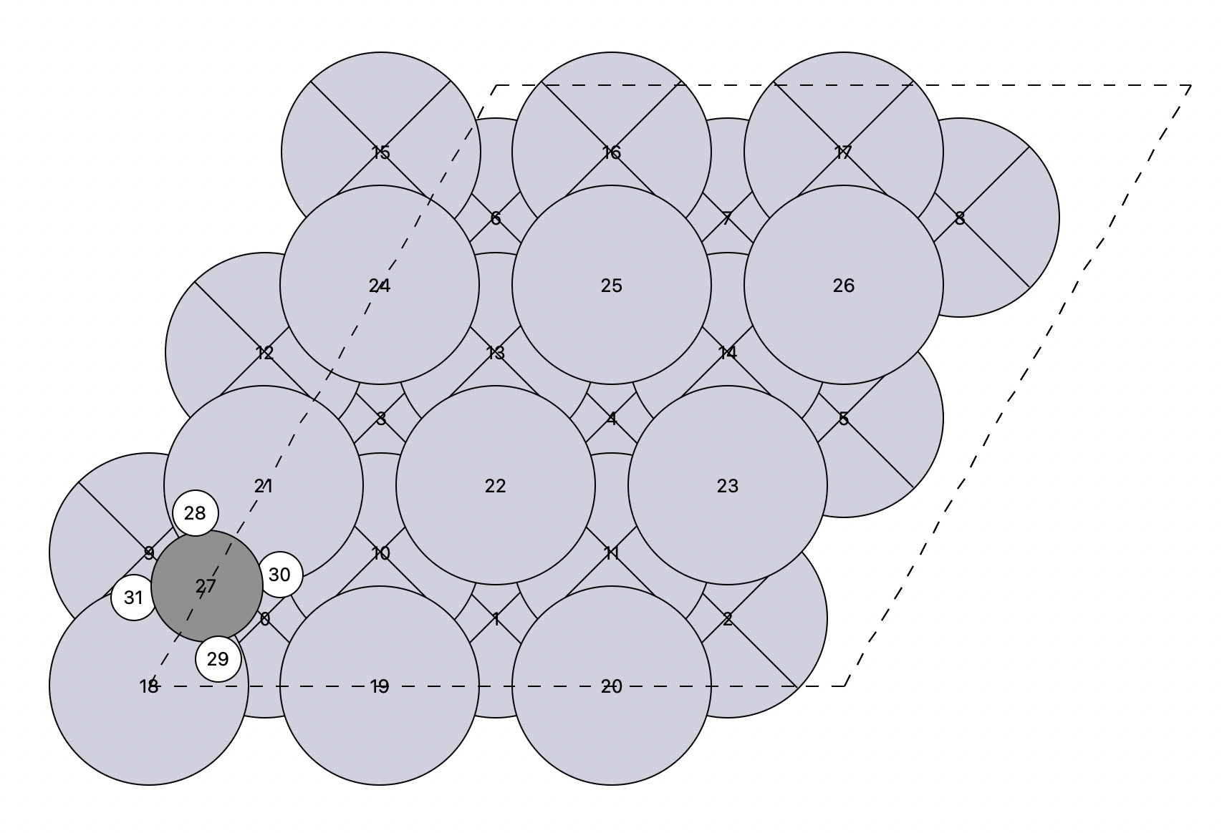
Pure Rotation at 120⁰ - Initial image as the Initial structure for translation
Initial
Saddle
Final

Slide 18


Slide 19


Slide 21
Anharmonic Correction

Slide 22
The purpose of Anharmonic Correction
Adsorption processes are often governed by weak interactions for which the estimation of entropy contributions by means of the harmonic approximation is prone to be inaccurate. Thermodynamic integration (TI) from the harmonic to the fully interacting system (λ-path integration) can be used to compute anharmonic corrections.
Weakly interacting adsorbates often exhibit anharmonic degrees of freedom such as dissociation (translation) and rotation, which are extremely poorly described

Slide 23
Using a quasi-harmonic approximation (QHA) for ethanol adsorption in H-ZSM5 zeolite, Alexopoulos et al. claimed that the traditional harmonic approximation overestimates adsorption free energies by 20−50 kJ mol−1
To date, accurate theoretical (but also experimental) reports on adsorption free energies are rare mostly in lack of accurate accounts for entropy. Even simple internal rotations in n-alkanes are incorrectly described by the harmonic approximation and have therefore been subject to numerous investigations.

Slide 24
Thermodynamic Integration
conventional TI techniques use Cartesian coordinates, which are inherently unsuitable for
systems with rotational and translational symmetries.
thermodynamic integration40−42 (TI) can be used to calculate free energies relative to a reference system over transformation paths other than the reaction path.
Cartesian coordinates fail to represent molecular vibrational motions of large amplitudes,22,23,60 potentially leading to unnecessarily large diﬀerences in energies between the harmonic reference and fully interacting system in practical simulations.
TI can be used to obtain anharmonic contributions with respect to a harmonic reference system.

Slide 25

Using rotationally and translationally invariant curvilinear coordinates, our formalism allows us to compute the anharmonic contribution to the free energy for any system that can be described with the harmonic
Approximation-independent of any reaction path. Our method allows for the theoretically exact calculation of a classical anharmonic correction to the harmonic-quantum or classical-approximation.

